Slide 1
Supporting the Software Product Line Evolution Through Aggregated Comprehension of Software Knowledge
Software Knowledge Comprehension and Reuse
Author: Jakub Perdek

Slide 2
The proper representation of software knowledge in place of variation points drives the effective modularization and reuse of software parts in the form of automatically derived resulting products, while the subsequent extraction with optional aggregation of this knowledge and associated information supports decision-making about the evolution of the software product line mainly based on differences between variants.
Notes:
Thesis:
The proper representation of software knowledge in place of variation points drives the effective modularization and reuse of software parts in the form of automatically derived resulting products, while the subsequent extraction with optional aggregation of this knowledge and associated information supports decision-making about the evolution of the software product line mainly based on differences between variants.

Slide 3
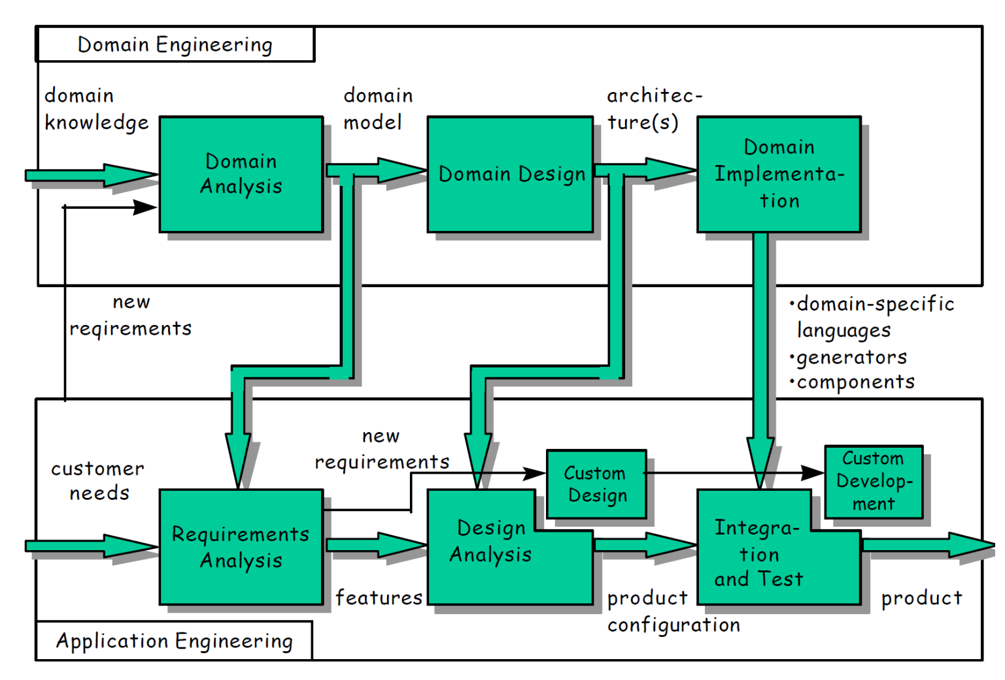
Software product lines
-to separate common
and variable
NEEDS DECOMPOSITION
AND GENERALIZATION
-to cover as much
variation
Development of components - For reuse
- well-established form of reuse for given domain
Code, tests, architectural design and other assets
- cheaper way of creating products according to the customer needs (user model)
to enable reuse in large [Nakagawa et al. 2011]
- additive integration of software parts (symmetric AOP)
- problematic features are incorporated without workarounds, redundancies, tangled, scattered code
Not repeating domain analysis for each product
Evolve in stages
Products in
Product Families
Derived in
Aspect-oriented software
product lines
Product instantiation - With reuse
TRANSFORMATION TO REUSABLE
components
Software product lines and domain engineering:
K. Czarnecki. Generative Programming: Principles and Techniques
of Software Engineering Based on Automated Configuration and
Fragment-Based Component Models. Ph.D. Thesis,

Slide 4
Studying the SPL evolution and variability
Less rigorous evaluations
of variability management
General handling of the variability is
still not fully covered/supported
by variability management
-knowledge modeling,
-applying principles of variability modeling
-simulating feature interactions
…to handle variability
M. Galster, D. Weyns, D. Tofan, B. Michalik, and P. Avgeriou.
Variability in software systems—a
systematic literature review. IEEE Transactions on
Software Engineering, 40(3):282–306, 2014.
various models and data representations are required for this purpose

Slide 5
Can our software product line be capable to support a high number of given requirements?
from possible “solution space” as the reaction
on the previous slide
Creating and managing
catalogs of “correct” annotated scripts
L. Chen, M. Ali Babar, and N. Ali. Variability management in software
product lines: A systematic review. pages 81–90, 01 2009.

Slide 6
Other possibilities
Data should be used further to detect defects and provide quality assurance between selected variants
L. Chen, M. Ali Babar, and N. Ali. Variability management in software
product lines: A systematic review. pages 81–90, 01 2009.

Slide 7
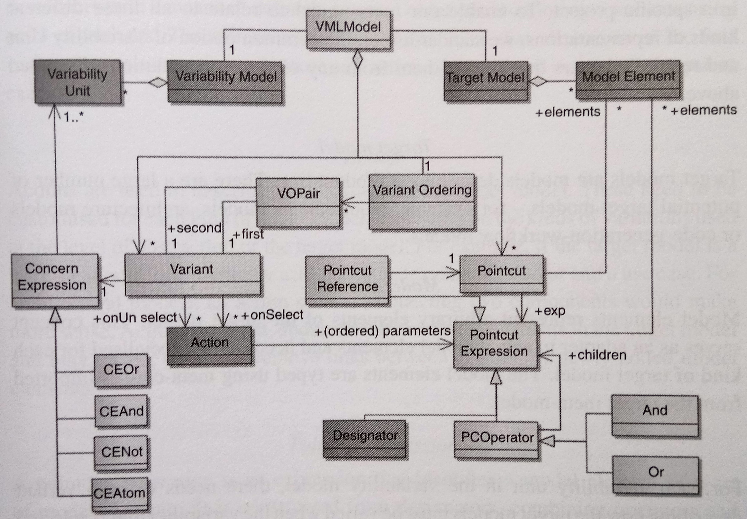
Meta-model Concepts
How target models vary, based on
DESCRIBED WITH VARIANT
„Adapters“ of
variability modeling
Describing product line
Selected
Unselected
FODA, DSL
Architecture,
requirement models...
Prescribed by variability model:
-what they may have
-constraints governing selections
1 to 1
mapping
Order of used actions
Set of
Denoted
by
DEFINE CONCERNS to variability
rather than target models
Define name for
With AND, OR NOT operators
VARIABILITY OPERATIONS
To handle:
-positive variability
-negative variability
Text to identify
set of model
elements
Name, wildcard
Enables the pointcut
expression to be build
Rashid, A., Royer, J., & Rummler, A. (Eds.). (2011). Aspect-Oriented, Model-Driven Software Product Lines: The AMPLE Way. Cambridge: Cambridge University Press. doi:10.1017/CBO9781139003629

Slide 8
Lightweight method for software product line feature management
Lightweight nature
Independent of the given programming language
No assumption about the development process or management is made
No need for specific DSL and other tools or plugins (but lacks traceability)
Managed by developers on their own, inside code specifically by annotating variable parts
Easy to comprehend and use
Only 3 associated actions given directly by annotation type – should be enough (+ another analytic versions and one recursive version can be perceived)
Expressions are not only conditional rules but domain knowledge should be inserted
Should be used in a native and modular way
The semantics of rules and derivation mechanism can be directly modified by developers according to their needs/observations

Slide 9
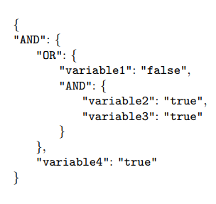
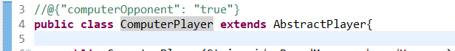
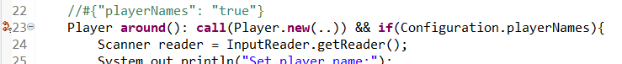
Applied annotations types
//@{}
//#{}
//%{}
For whole
class/aspect/interface
For class/aspect
method only
For import
statement only
Copying of whole
file with class
Copying of
given method
Copying of
given import
//@{}
//#{}
//%{}

Slide 10
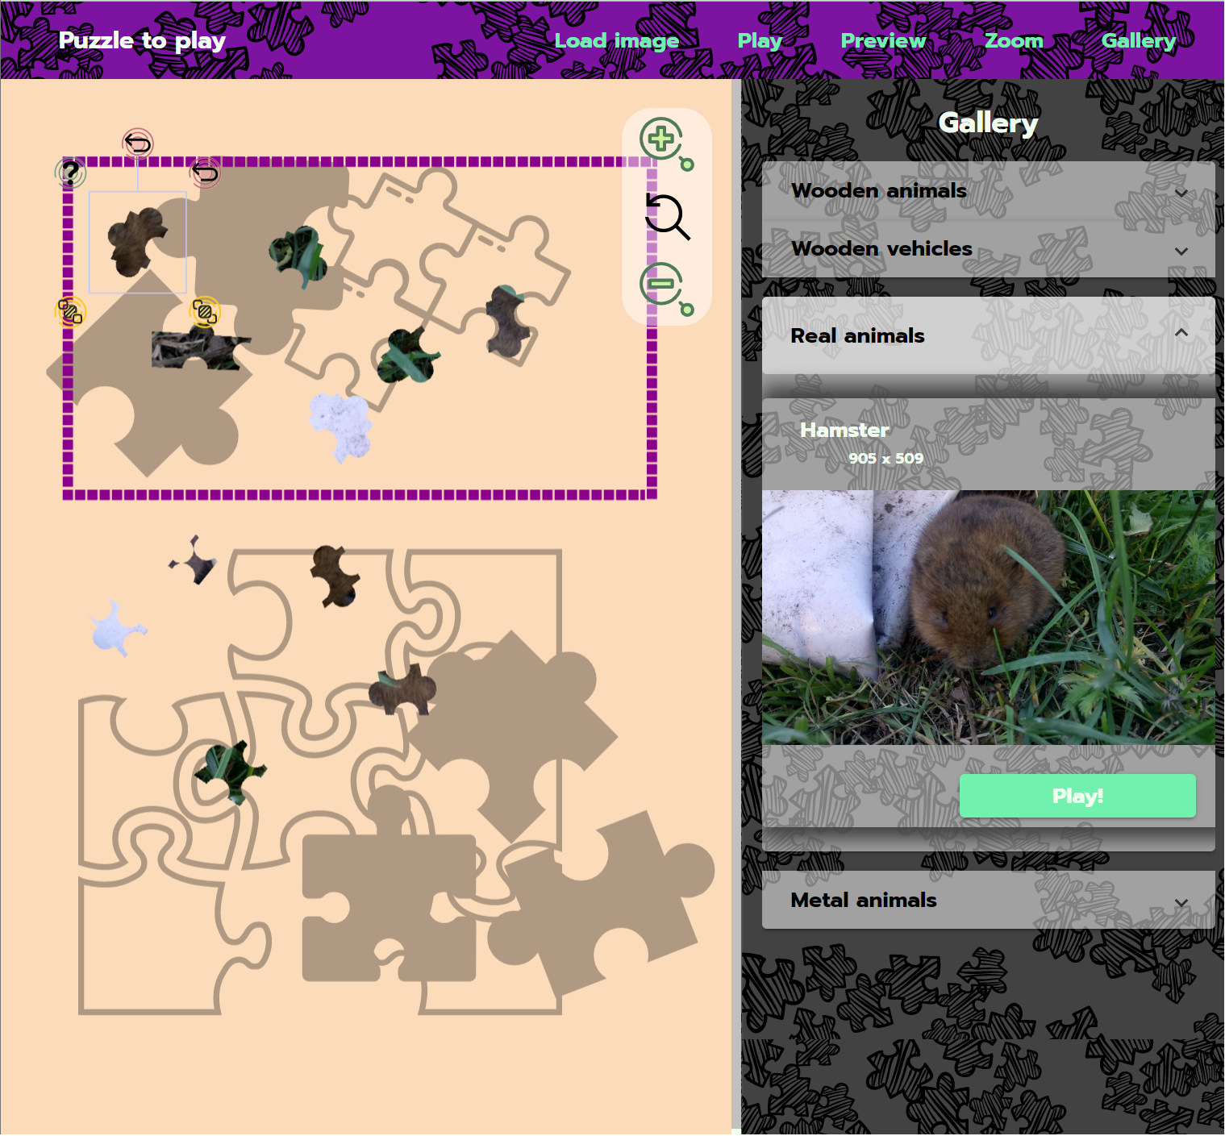
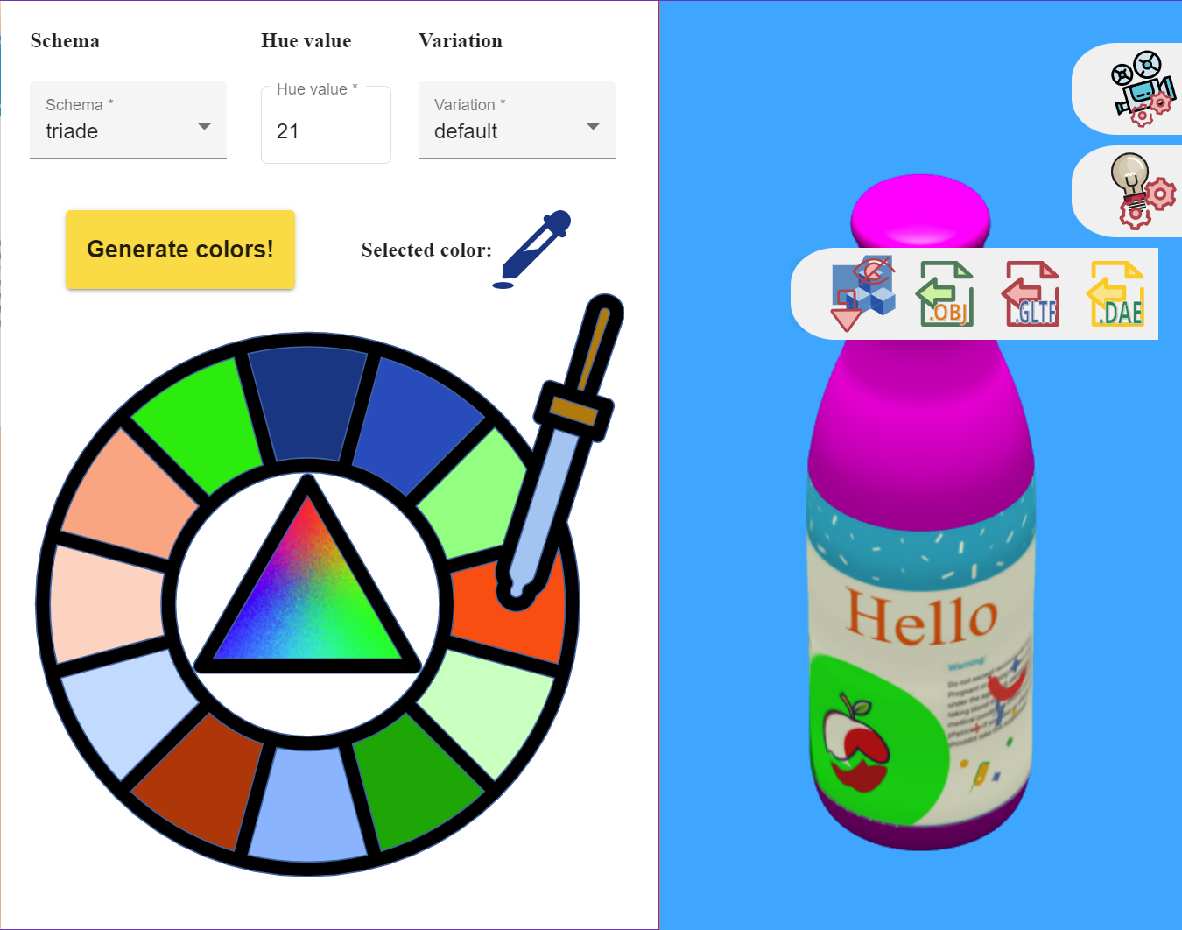
Application in TypeScript
NO ASPECTS
IN PRODUCTS

Slide 11
SPL Process
1. Separating aspects from business logic
2. Adding business logic and annotating variable parts
3. Deriving requested products from SPL with NO ASPECTS
//${}|[path]|number_block
-proposed annotation to reduce code duplication
PROPOSED WHEN ASPECTS SHOULD NOT BE INCLUDED IN RESULTING DERIVATIONS

Slide 12
TypeScript product families
In one application (without backend if necessary)
Accessible from everywhere (from the browser)
High UX possible (known elements, reactive forms, own routing,…)
Possibility to easily evolve SPL
Possibility to easily evolve product derivation (aspects are not dependent here)
Reusing proven solutions (resizing canvas (board) during play, rendering algorithms,..)
Customization of graphic libraries for each specific case
Managing small variability changes across many types of products and requirements
ASPECTS FOR SPL
FEATURE MANAGEMENT
GETTING RID OF ASPECTS IN
RESULTING PRODUCT DERIVATIONS

Slide 13
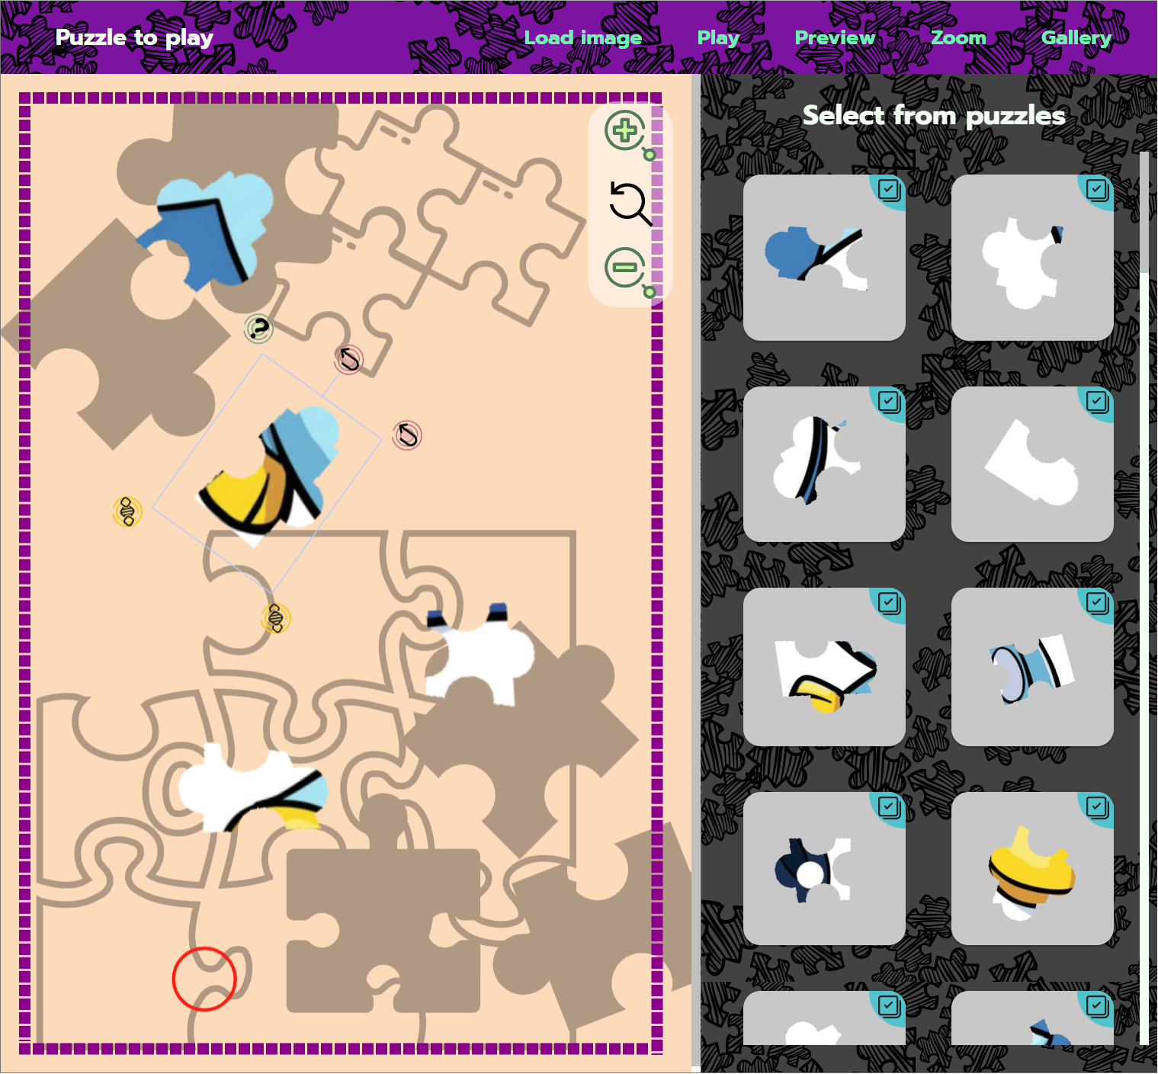
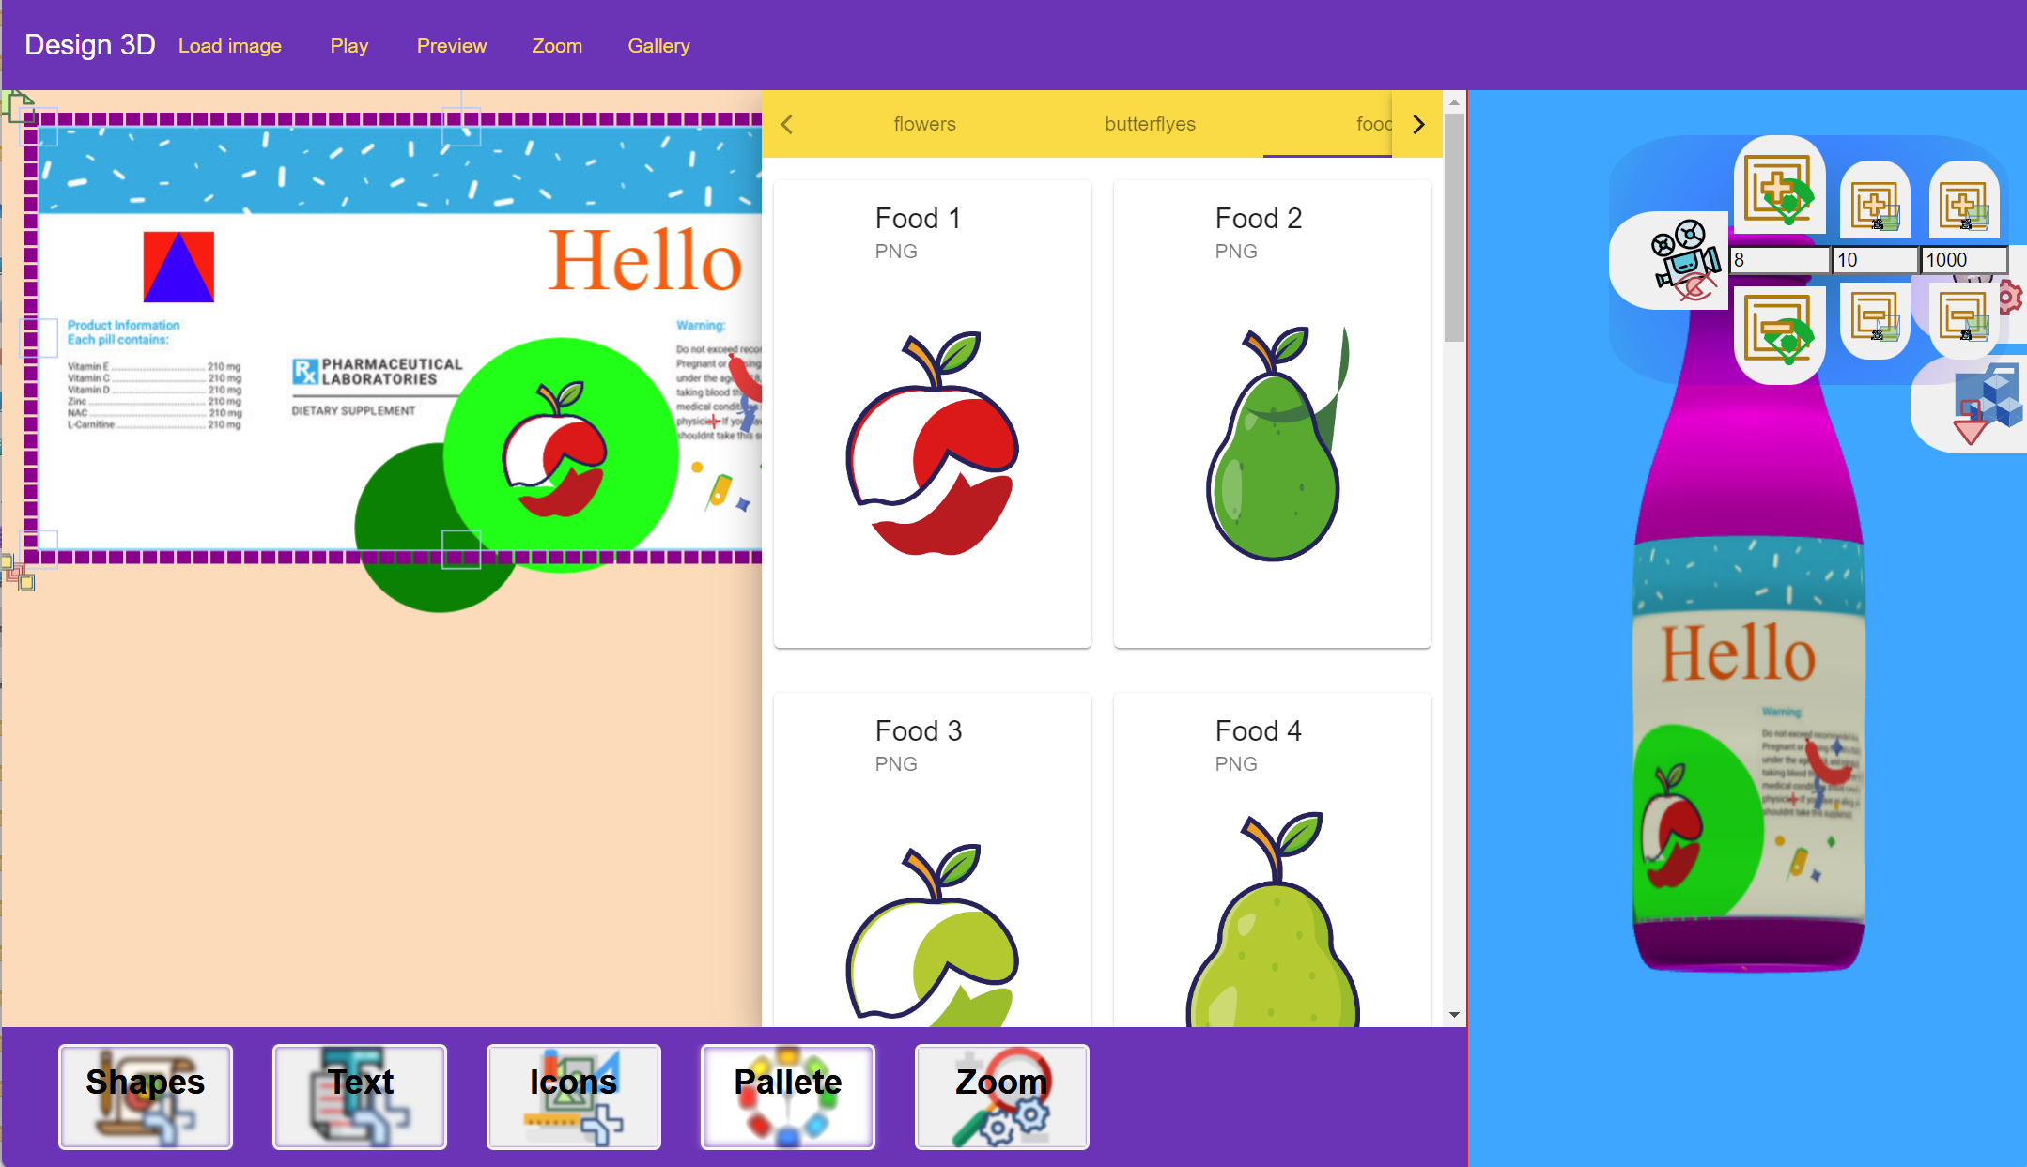
Commonality
vs. Variability
Puzzle app.
vs.
Desing app.

Slide 14
Restrictions of using aspects in TypeScript
BRIEFNESS
How easy, how exactly,
and without
complications is possible
to use a given tool
MATURITY
INVASIVENESS
All abilities and possibilities of
the whole functionality
provided by a given library
How well aspects are separated
from the rest of the code
Komponent / Nástroj | AspectScript | AOJS | AspectJS
Invasiveness | - | + | -
Briefness | ++ | + | ++
Maturity | ++ | - | -
Wenhao Huang, Chengwan He, and Zheng Li. 2015.
A Comparison of Implementations for Aspect-Oriented
JavaScript:. Zhengzhou, China.
https://doi.org/10.2991/csic-15.2015.9
Ricardo Sá Loureiro Ferreira da Silva. 2019. Aspect-Oriented Programming for Javascript using the Lara Language. Dissertation thesis. Universidade do Porto, Porto.
The comparison of AOP tools
(Huang et al. 2015)

Slide 15
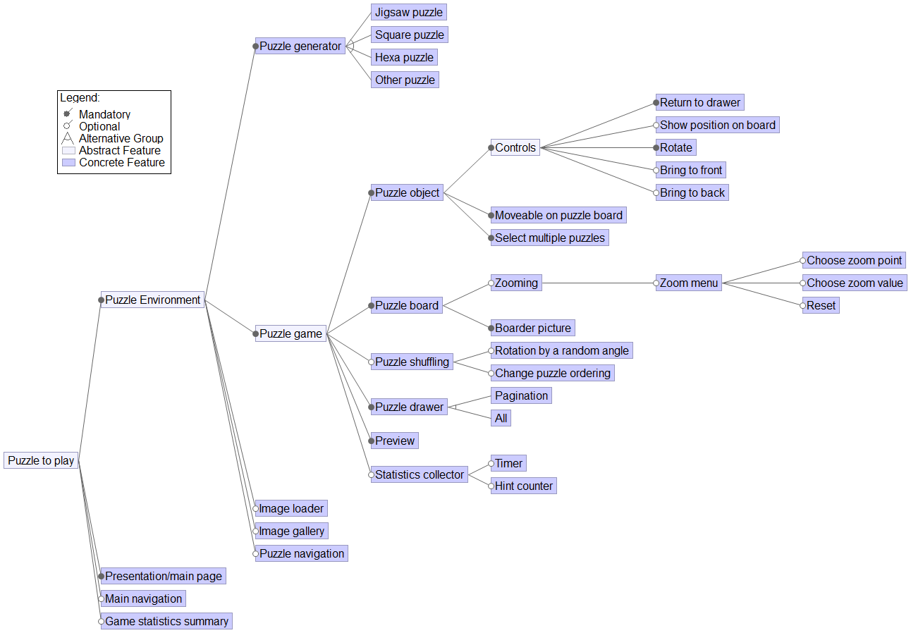
Feature model

Slide 16
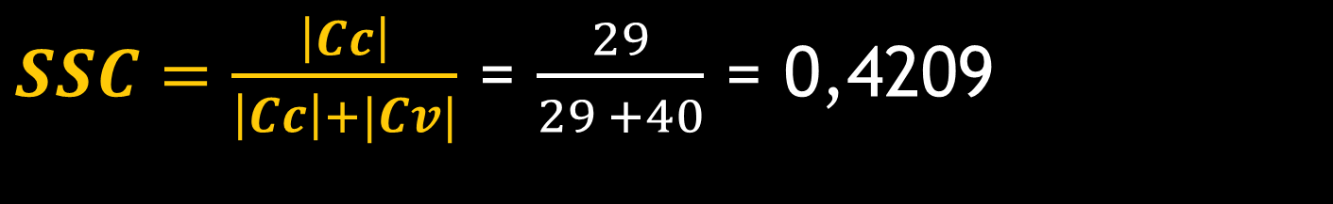

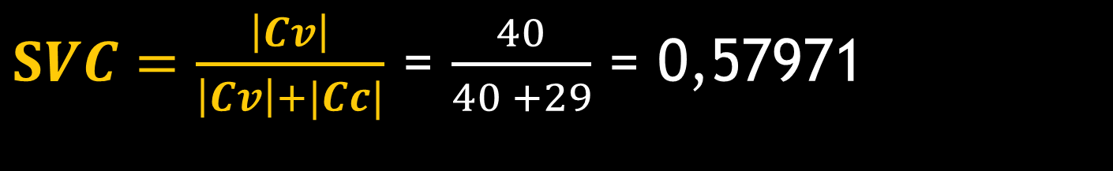
Evaluation of our Angular SPL
$SSC=\frac{\left|Cc\right|}{\left|Cc\right|+|Cv|}$ = $\frac{29}{29 +40}$ = 0,4209
The more commonality, the…
BETTER REUSE OF ASSETS ACROSS
PRODUCT FAMILY MEMBERS (PRODUCTS)
$SVC=\frac{\left|Cv\right|}{\left|Cv\right|+|Cc|}$ = $\frac{40}{40 +29}$ = 0,57971
The more variability, the…
BETTER USER MENTAL MODEL SUPPORT
If some features are conditionally common,
then in our assumption are evaluated as variable
Sum of components k
$$RBR=\frac{\text{Σ}\text{k} \text{Cost} \text{C}\text{k}}{\text{Σ}\text{j} \text{Cost} \text{C}}$$
Value of given component
C is measured by LOC
(the lines of code)
TypeScript code (fc=3),
template code (ft=2)
styles (fs=0.25)
Sum of all
components in SPL
Additive results for variation points are shown in the next table

Slide 17
CREATING MULTI-CONTENT AND MULTI-PURPOSE FRACTAL DATASET
MULTI-CONTENT
MULTI-PURPOSE
-JSON data from variability points
-raster screenshots/images
-vector SVG structure information
-table from the variability information itself
-data from recursion
-aesthetic evaluation
-comparing the same models on
different data formats
-SPL evolution through variability points evaluation
– if they should be included or merged
-associating products with their generators/software parts
-generate the similar fractals using GANS
Many of them can be
often generalized
RECURSION IN SPL
The same code parts are repeatedly reused – with different values
HOW IT AFFECTS VARIABILITY MODELING?

Slide 18
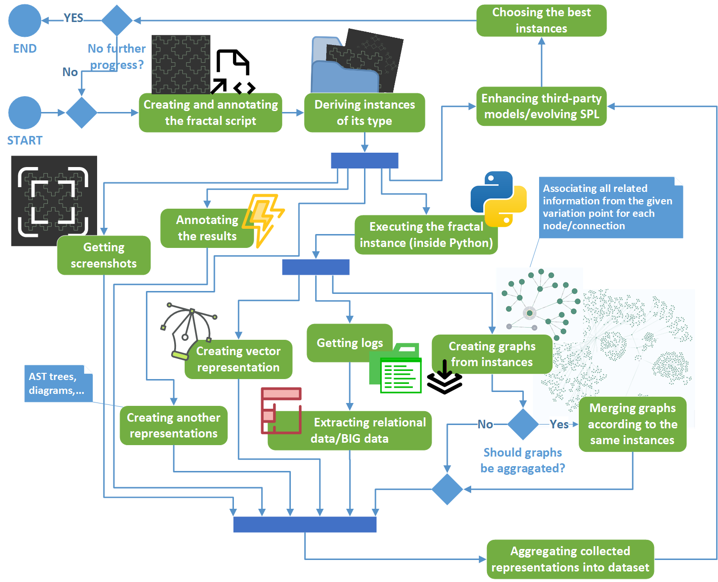

Slide 19
Why fractals?
Are they necessary? – YES
Multiple format representations (vector, raster, text)
All images can be converted to SVG, but not all are suitable as shapes – bigger, better more points – image quality
We can use them as already created “products”
No other dependencies - easy to execute code and get values from the execution
Code that is executed repeatedly
Variability management on lower levels (code level) – components are not suitable
Variability reaches a “high degree” – almost everything is variability
No reuse? – NO in recursion there is high reuse, also across all types of derivations
Many samples can be generated – also merging existing ones
Thousands – already hundreds of quality ones from one type
Not all are aesthetic or interesting

Slide 20
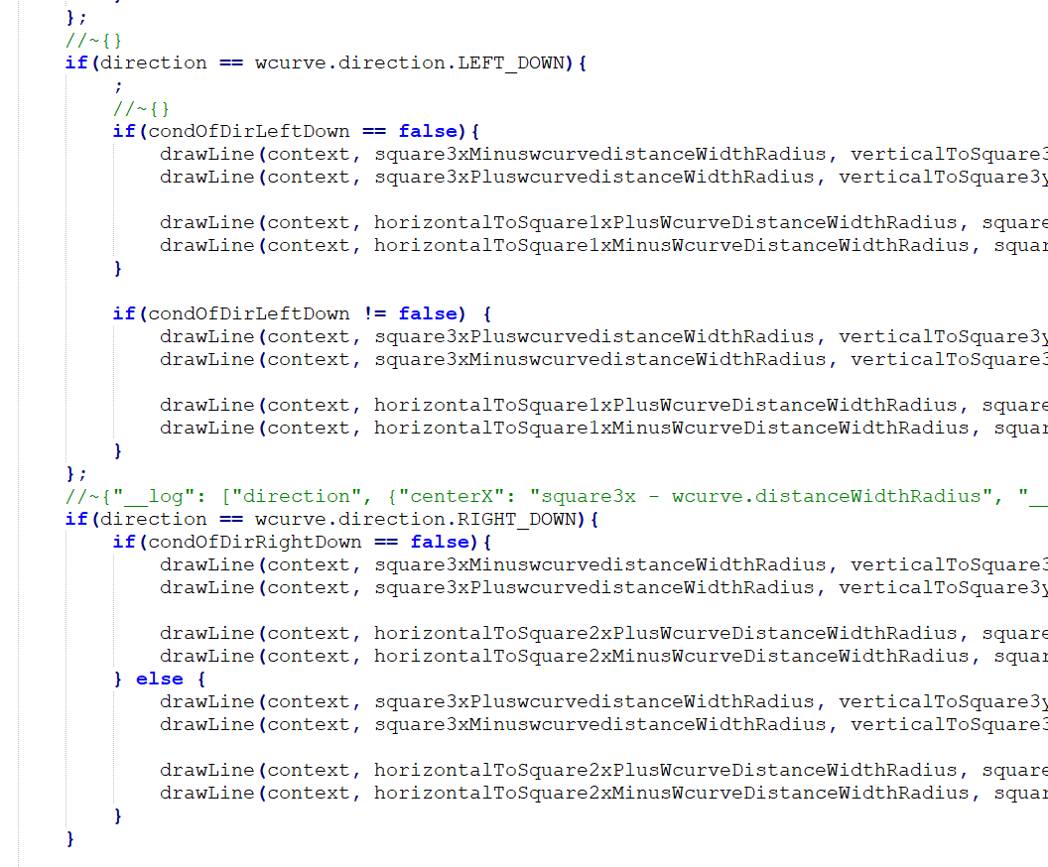
Method based on annotations and aspects – recursive extension
still compilable
Only one small script is enough
for 378 samples, but generating fractals
in for cycles still produces
a few same shapes
-translation is not productive

Slide 21
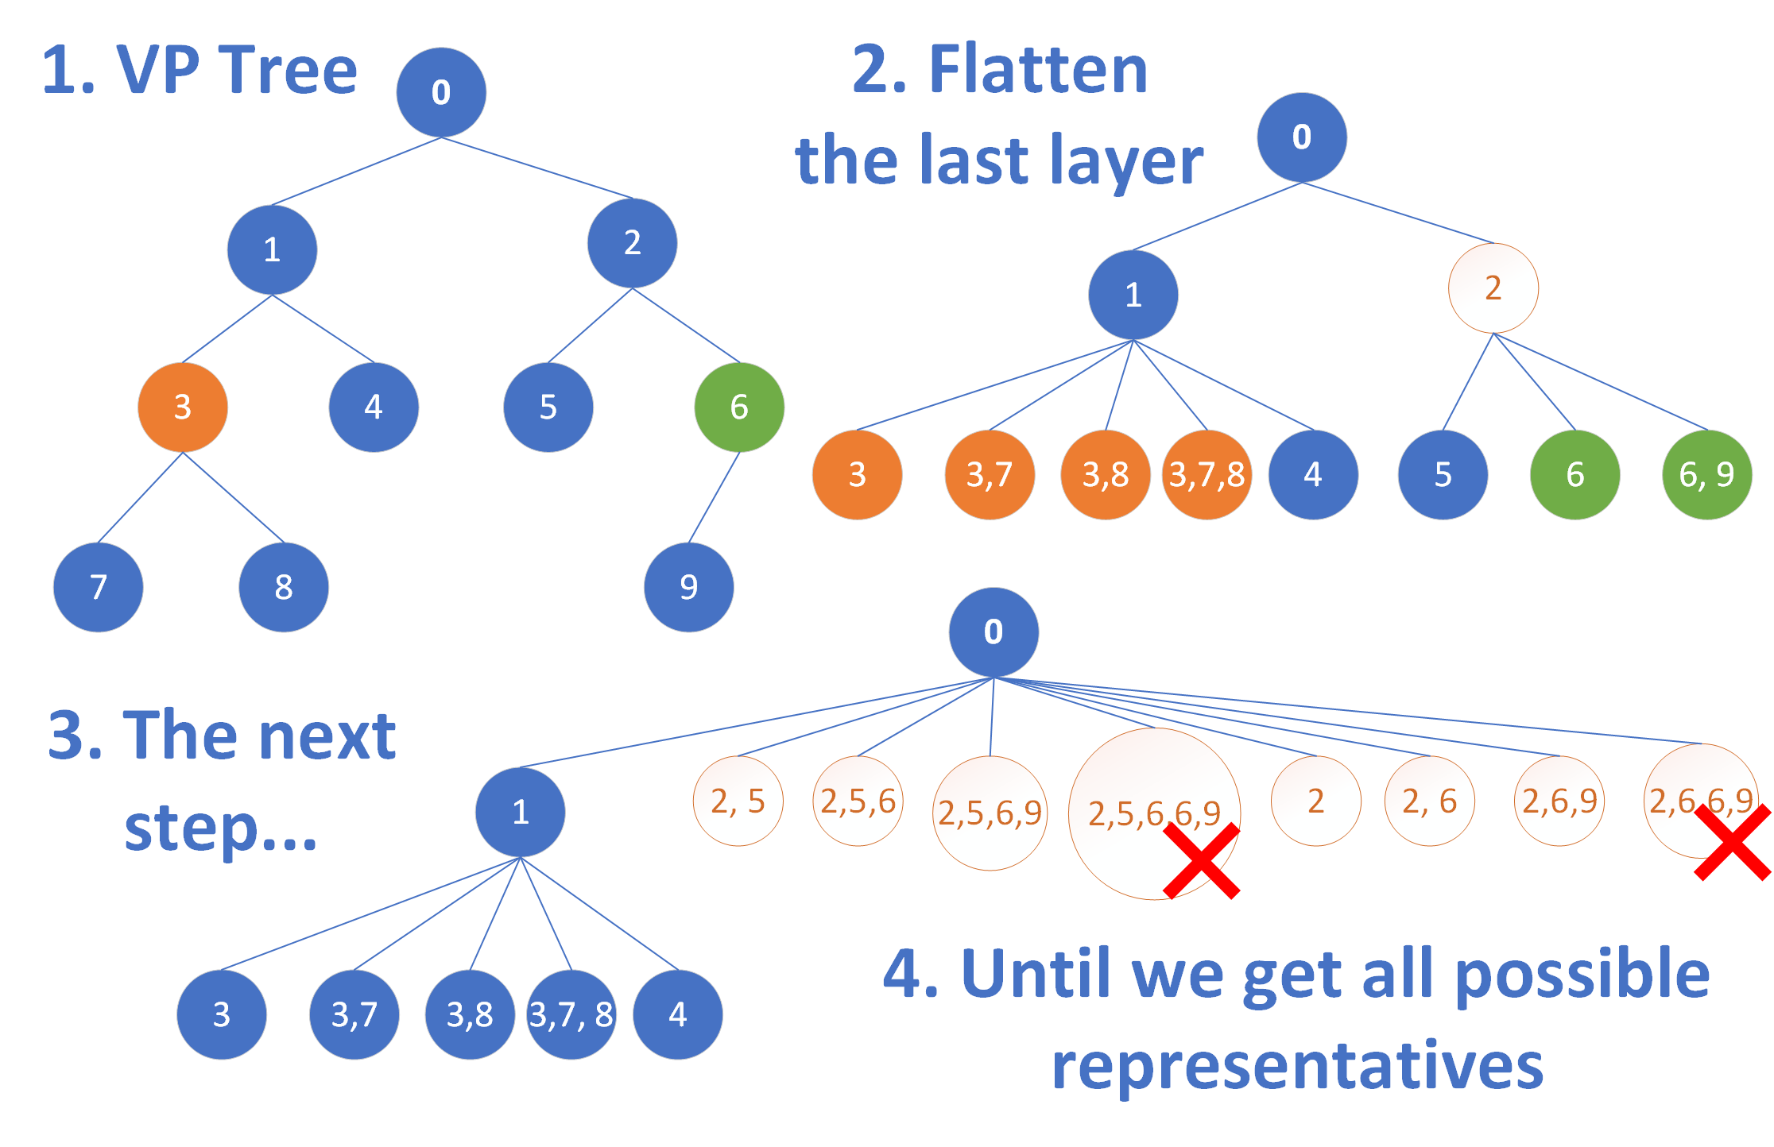

Slide 22
Creating tree from these points
//~{}

Slide 25
Creating the best representations
... according to the given requirements for model construction and evaluation of aesthetics ...

Slide 26
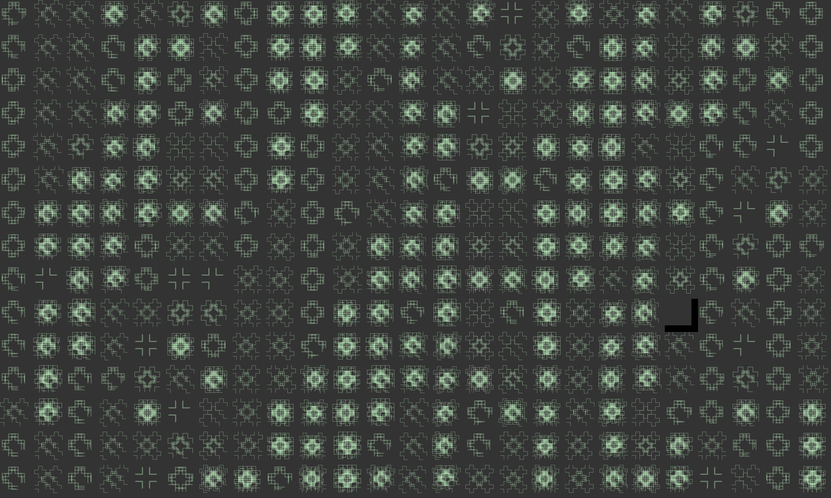
Raster screenshots

Slide 27
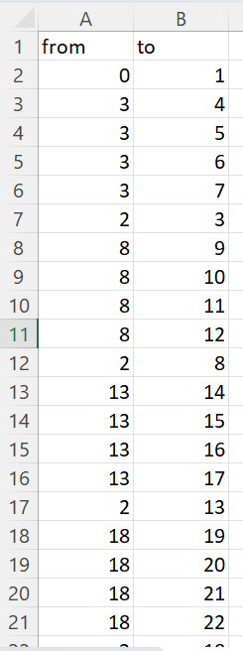
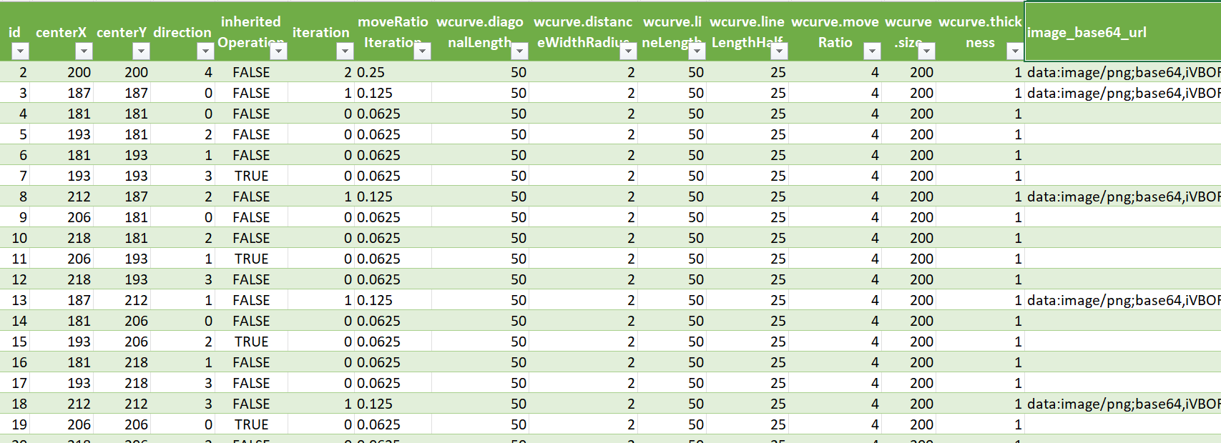
Graph data – nodes and connections
Aggregation
of instances
One instance

Slide 28
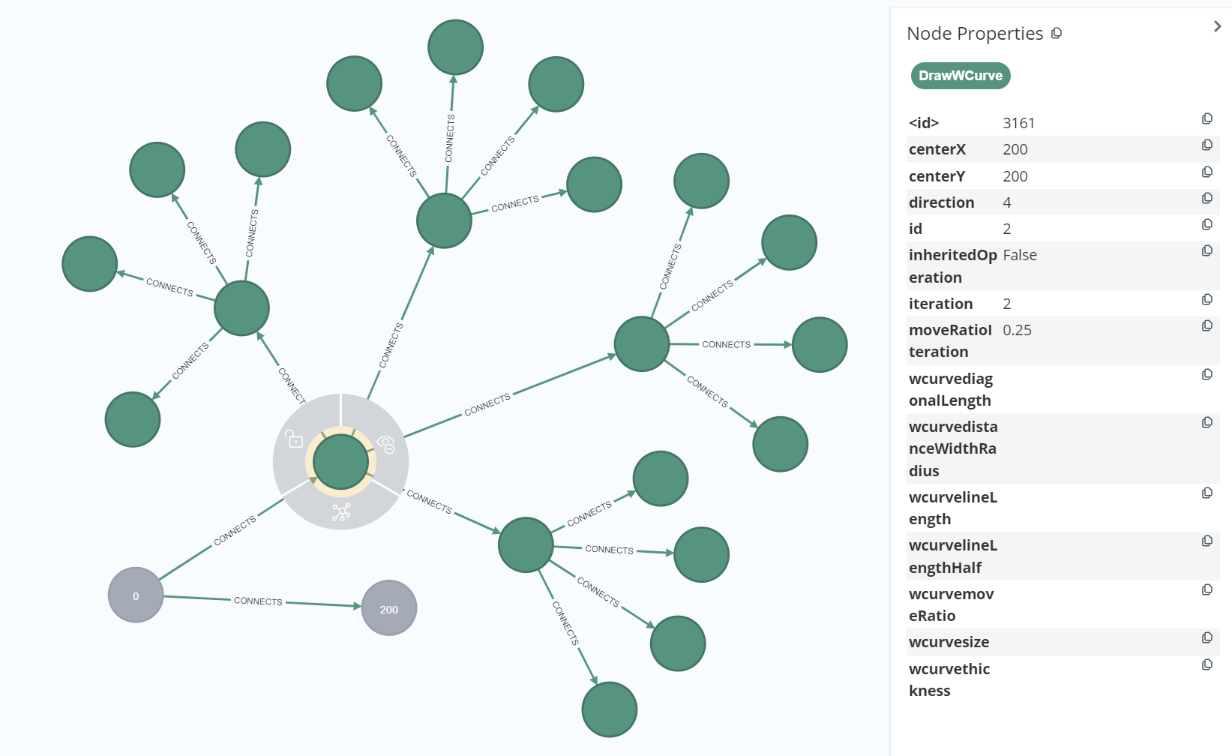

Slide 29
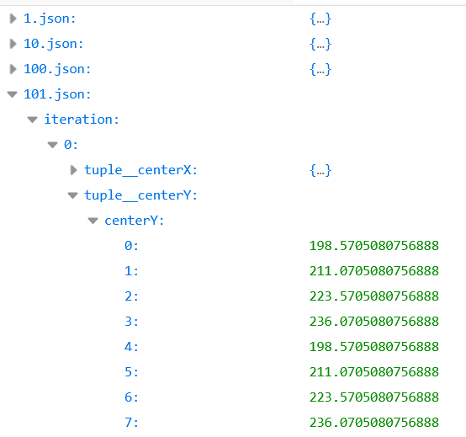
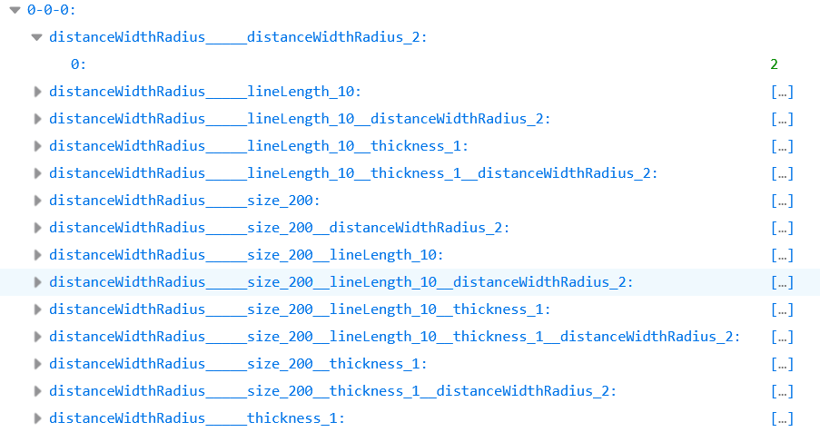
Semi-structured data – variable dependencies
recursion depth as reusability of the components:

Slide 30
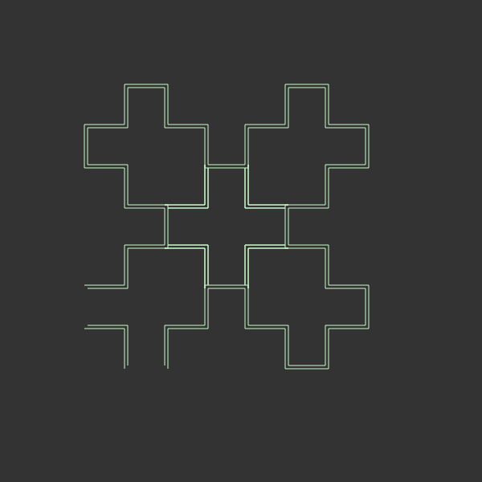

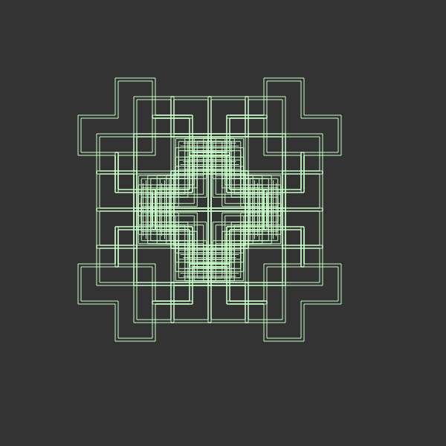
Results after SPL creation
doubled W-curves
- THE RESULT SHOULD REMAIN A FRACTAL
- SYMMETRY IS THE BEST
- ASYMMETRY OFTEN DOES NOT LOOK SO GOOD
Some results are enhanced,
if another recursion functionality depends on it
- MAKING MORE INSTANCES OFTEN RESULTS
IN CHAOS IN A FEW PLACES IN THE IMAGE
LOGGING CAN PROVIDE „FACTORIALS“ OF DATA
GENERATED DATA ARE ONLY IN
FORM OF KEY-VALUE PAIRS

Slide 31





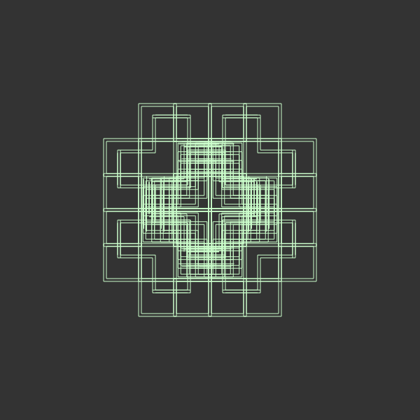
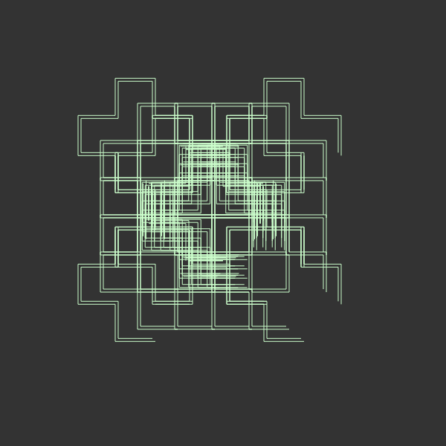
Already 378 fractals generated from one file
Can be more, but...
we bring:
asymmetry, chaos, standalone lines
creating non-fractal shape
EASY TO EXECUTE AND
ANALYZE FRACTAL SCRIPT
IN MANY PROGRAMMING
LANGUAGES
js2py for Python

Slide 32
Step wise logistic regression
Without images, on structured data – dependencies on recursion depth as separate columns
multinom(perceivedAesthetics ~ ., family=multinomial,
data = variablePointDataTrain[usedColnames]) %>% stepAIC(trace = FALSE, direction="both")
Evaluating accuracy:
print(mean(predictedValues == observedValues))
Restricted to the maximal number of 110 columns
for this small evaluated dataset … NOT ENOUGH
Test ACC: 0.3421 GOOD

Slide 33
GNN – accuracy and loss
Without images, on graph data
Model: "gnn_model"
_________________________________________________________________
Layer (type) Output Shape Param #
=================================================================
preprocess (Sequential) (38376, 32) 1396
graph_conv1 (GraphConvLayer multiple 5888
)
graph_conv2 (GraphConvLayer multiple 5888
)
postprocess (Sequential) (38376, 32) 2368
logits (Dense) multiple 330
=================================================================
Total params: 15,870
Trainable params: 15,028
Non-trainable params: 842
_________________________________________________________________
Test ACC: 0.7133
Formatted data according domain knowledge

Slide 34
Finding the best model for aesthetics assignment
Used model | Accuracy one user | Accuracy AI LeNet model
LeNet (input size 28x28) | 0,3158 | 0,8487
LeNet (input size 600x600) | 0,3421 | 0,8618
LeNet multimodel for image with coordinates (input size 600x600) | 0,2697 | 0,7961
Multinomial logistic regression based on coordinates | 0,3618 | 0,8092
Stepwise logistic regression based on coordinates (backward) | 0,3421 | 0,7894
Stepwise logistic regression based on coordinates (forward) | 0,4539 | 0,7960
Stepwise logistic regression based on coordinates (both) | 0,4539 | 0,7961
Graph neural network + coordinates | 0,7133 | 0,6999

Slide 35
Results
The
proper representation of software knowledge in place of variation points
essential information (knowledge) about software put inside annotation or found in their place (a form of tracing from lit.)
Annotated by our annotations
drives the
automatically derived
resulting products
effective modularization and reuse
of software parts in the form of
Restricted use of our annotations (their actions from lit.)
to force organize variable code in a native and modular way
in parallel with the help of the aspects
The derivation process is automated
while the
subsequent extraction
with optional aggregation
of this
The mechanism is adapted to extract given
information from code fragment (also dynamic one)
Also knowledge from heterogeneous applications
can be analyzed with the rest of the software family
knowledge and associated information
of the software product
line mainly based on
differences between
variants
supports decision-making about the evolution
Knowledge can be connected and used in various models that are
designed for automated decision-making about SPL evolution, its evaluation
Knowledge mainly captures
differences between members
The proper representation of software knowledge in place of variation points drives the effective modularization and reuse of software parts in the form of automatically derived resulting products, while the subsequent extraction with optional aggregation of this knowledge and associated information supports decision-making about the evolution of the software product line mainly based on differences between variants.
Notes:
.

Slide 36
Resulting capabilities
To study managed software product line evolution in its automated form
with the possibility to integrate it with available evolution algorithms
Applied principles of variability modeling, knowledge modeling, and feature interactions (from data of resulting products)
use machine learning/deep learning marginally by applying a wide range of features
fast and cheap way to observe different possibilities
To study managed software product lines in large
Possibility to analyze restricted use of annotations (our approach) applied in variation points and available actions to preserve modularity, native development (exchangeable with decorators in TypeScript), and comprehensive code
Multi-content and Multi-Purpose dataset built from knowledge based on similarity in product family + capability to compare and design different models
No existing one which contains various formats accompanied with launchable applications/products exists (according to our observations on Kaggle or from the internet)
Identified extensions to expressions inside annotations to fill gaps during product instantiation

Slide 37
Future work
Automatically evolve fractal products with the help of the extracted knowledge
Continue manually evolve stateful canvas-based SPL
Evaluate recreated annotations into TypeScript decorators in comparison with code without them (modularity, coupling, and possible applications of aspects)
Provide functionality to automatically insert these decorators into AST of TypeScript code
Design other advanced models capable to evaluate quality according to the requirements including GANs and Transformers
Add semantics support for the aggregation mechanism
Another possibility: Model a given knowledge further (in knowledge bases)
What next?
Implement and compare other mechanisms for variability management such as pure::variants
Extend the solution to support new variants and evaluate its quality
Build GAN to generate similar fractals – analyze the impact of the product in SPL evolution
try to design variation points based on the best ones
Notes:
.

Slide 38
Bibliography
BEUCHE, Danilo a Mark DALGARNO, 2006. Software Product Line Engineering with Feature Models. 2006, s. 7.
BOTTERWECK, Goetz, Kwanwoo LEE a Steffen THIEL, 2009. Automating Product Derivation in Software Product Line Engineering. 2009, s. 6.
KASTNER, Christian, Sven APEL a Don BATORY, 2007. A Case Study Implementing Features Using AspectJ. V: 11th International Software Product Line Conference (SPLC 2007): 11th International Software Product Line Conference (SPLC 2007) [online]. Kyoto, Japan: IEEE, s. 223–232 [cit. 30.9.2021]. ISBN 978-0-7695-2888-5. Dostupné na: doi:10.1109/SPLINE.2007.12
LADDAD, Ramnivas, 2003. AspectJ in action: practical aspect-oriented programming. Greenwich, CT: Manning. ISBN 978-1-930110-93-9.
PELÁNEK, Radek, 2012. Programátorská cvičebnice. 1. vydání. Brno: Computer press. ISBN 978-80-251-3751-2.
VRANIC, Valentino a Roman TÁBORSKÝ, 2016. Features as transformations: A generative approach to software development. Computer Science and Information Systems [online]. 2016, roč. 13, č. 3, s. 759–778. ISSN 1820-0214, 2406-1018. Dostupné na: doi:10.2298/CSIS160128027V
YOUNG, Trevor J a B MATH, 1999. Using AspectJ to Build a Software Product Line for Mobile Devices. 1999, s. 73.

Slide 39
Mohammad Abu-Matar and Hassan Gomaa. 2011. Variability Modeling for Service Oriented Product Line Architectures. In 2011 15th International Software Product Line Conference. IEEE, Munich, Germany, 110–119. https://doi.org/10.1109/ SPLC.2011.26
Hwi Ahn and Sungwon Kang. 2011. Analysis of Software Product Line Architecture Representation Mechanisms. In 2011 Ninth International Conference on Software Engineering Research, Management and Applications. IEEE, Baltimore, MD, USA, 219–226. https://doi.org/10.1109/SERA.2011.22
S.A. Ajila. 2005. Reusing Base-product Features to develop Product Line Architecture. In IRI -2005 IEEE International Conference on Information Reuse and Integration, Conf, 2005. IEEE, Las Vegas, NV, USA, 288–293. https://doi.org/10.1109/ IRI-05.2005.1506488
Samuel A Ajila and Patrick J Tierney. 2002. The FOOM Method – Modeling Software Product Lines in Industrial Settings. (2002), 11.
Vander Alves, Pedro Matos Jr, and Paulo Borba. 2004. An Incremental Aspect-Oriented Product Line Method for J2ME Game Development. (2004), 3.
Vander Alves, Pedro Matos, Leonardo Cole, Alexandre Vasconcelos, Paulo Borba, and Geber Ramalho. 2007. Extracting and Evolving Code in Product Lines with Aspect-Oriented Programming. In Transactions on Aspect-Oriented Software Development IV, David Hutchison, Takeo Kanade, Josef Kittler, Jon M. Kleinberg, Friedemann Mattern, John C. Mitchell, Moni Naor, Oscar Nierstrasz, C. Pandu Rangan, Bernhard Steffen, Madhu Sudan, Demetri Terzopoulos, Doug Tygar, Moshe Y. Vardi, Gerhard Weikum, Awais Rashid, and Mehmet Aksit (Eds.). Vol. 4640. Springer Berlin Heidelberg, Berlin, Heidelberg, 117–142. https://doi.org/10.1007/978-3-540-77042-8_5 Series Title: Lecture Notes in Computer Science.

Slide 40
Fazal-e Amin, Ahmad Kamil Mahmood, and Alan Oxley. 2010. A Review on Aspect Oriented Implementation of Software Product Lines Components. Information Technology Journal 9, 6 (Aug. 2010), 1262–1269. https://doi.org/10.3923/itj.2010. 1262.1269
Michalis Anastasopoulos and Dirk Muthig. 2004. An Evaluation of Aspect-Oriented Programming as a Product Line Implementation Technology. In Software Reuse: Methods, Techniques, and Tools, Jan Bosch and Charles Krueger (Eds.). Vol. 3107. Springer Berlin Heidelberg, Berlin, Heidelberg, 141–156. https://doi.org/10.1007/978-3-540-27799-6_12 Series Title: Lecture Notes in Computer Science
Sven Apel, Thomas Leich, and Gunter Saake. 2006. Aspectual mixin layers: aspects and features in concert. In Proceedings of the 28th international conference on Software engineering. ACM, Shanghai China, 122–131. https://doi.org/10.1145/ 1134285.1134304
U. Aßmann. 2003. Invasive Software Composition. Springer-Verlag, Berlin, Heidelberg
M.A. Babar. 2004. Scenarios, Quality Attributes, and Patterns: Capturing and Using their Synergistic Relationships for Product Line Architectures. In 11th Asia-Pacific Software Engineering Conference. IEEE, Busan, Korea, 574–578. https: //doi.org/10.1109/APSEC.2004.91
Felix Bachmann and Len Bass. 2001. Managing Variability in Software Architectures. (2001), 7.
L. Balzerani, D. Di Ruscio, A. Pierantonio, and G. De Angelis. 2005. A product line architecture for web applications. In Proceedings of the 2005 ACM symposium on Applied computing - SAC ’05. ACM Press, Santa Fe, New Mexico, 1689. https://doi.org/10.1145/1066677.1067059

Slide 41
Gérald Barré. 2018. Aspect Oriented Programming in TypeScript. https://www.meziantou.net/aspect-oriented-programmingin-typescript.htm
Don Batory, Rich Cardone, and Yannis Smaragdakis. 2000. Object-Oriented Frameworks and Product Lines. In Software Product Lines, Patrick Donohoe (Ed.). Springer US, Boston, MA, 227–247. https://doi.org/10.1007/978-1-4615-4339-8_13
Joachim Bayer, Oliver Flege, and Cristina Gacek. 2000. Creating Product Line Architectures. In Software Architectures for Product Families, Gerhard Goos, Juris Hartmanis, Jan van Leeuwen, and Frank van der Linden (Eds.). Vol. 1951. Springer Berlin Heidelberg, Berlin, Heidelberg, 210–216. https://doi.org/10.1007/978-3-540-44542-5_23 Series Title: Lecture Notes in Computer Science.
Ivo Augusto Bertoncello, Marcelo Oliveira Dias, Patrick H. S. Brito, and Cecília M. F. Rubira. 2008. Explicit exception handling variability in component-based product line architectures. In Proceedings of the 4th international workshop on Exception handling - WEH ’08. ACM Press, Atlanta, Georgia, 47–54. https://doi.org/10.1145/1454268.1454275
Vinicius Bischoff, Kleinner Farias, Lucian José Gonçales, and Jorge Luis Victória Barbosa. 2019. Integration of feature models: A systematic mapping study. Information and Software Technology 105 (Jan. 2019), 209–225. https://doi.org/10. 1016/j.infsof.2018.08.016
Lynne Blair and Jianxiong Pang. 2003. Aspect-Oriented Solutions to Feature Interaction Concerns using AspectJ. (2003), 17.
Jan Bosch. 2000. Design & Use of Software Architectures—Adopting and Evolving a Product Line Approach.

Slide 42
Jan Bosch, Gert Florijn, Danny Greefhorst, Juha Kuusela, J. Henk Obbink, and Klaus Pohl. 2002. Variability Issues in Software Product Lines. In Software Product-Family Engineering, Gerhard Goos, Juris Hartmanis, Jan van Leeuwen, and Frank van der Linden (Eds.). Vol. 2290. Springer Berlin Heidelberg, Berlin, Heidelberg, 13–21. https://doi.org/10.1007/3-540-47833-7_3 Series Title: Lecture Notes in Computer Science
Jonathan Cardoso. 2021. How To Use Decorators in TypeScript. https://www.digitalocean.com/community/tutorials/howto-use-decorators-in-typescript
João M.P. Cardoso, Tiago Carvalho, José G.F. Coutinho, Wayne Luk, Ricardo Nobre, Pedro Diniz, and Zlatko Petrov. 2012. LARA: an aspect-oriented programming language for embedded systems. In Proceedings of the 11th annual international conference on Aspect-oriented Software Development - AOSD ’12. ACM Press, Potsdam, Germany, 179. https://doi.org/10.1145/2162049.2162071
Adrian Colyer, Awais Rashid, and Gordon Blair. 2004. On the Separation of Concerns in Program Families. (2004), 11
Tung M. Dao and Kyo C. Kang. 2010. Mapping Features to Reusable Components: A Problem Frames-Based Approach. In Software Product Lines: Going Beyond, David Hutchison, Takeo Kanade, Josef Kittler, Jon M. Kleinberg, Friedemann Mattern, John C. Mitchell, Moni Naor, Oscar Nierstrasz, C. Pandu Rangan, Bernhard Steffen, Madhu Sudan, Demetri Terzopoulos, Doug Tygar, Moshe Y. Vardi, Gerhard Weikum, Jan Bosch, and Jaejoon Lee (Eds.). Vol. 6287. Springer Berlin Heidelberg, Berlin, Heidelberg, 377–392. https://doi.org/10.1007/978-3-642-15579-6_26 Series Title: Lecture Notes in Computer Science.
Ebru Dincel, Nenad Medvidovic, and André van der Hoek. 2002. Measuring Product Line Architectures. In Software Product-Family Engineering, Gerhard Goos, Juris Hartmanis, Jan van Leeuwen, and Frank van der Linden (Eds.). Vol. 2290. Springer Berlin Heidelberg, Berlin, Heidelberg, 346–352. https://doi.org/10.1007/3-540-47833-7_31 Series Title: Lecture Notes in Computer Science.
Chethana Kuloor Armin Eberlein. 2002. Requirements Engineering for Software Product Lines. (2002), 12

Slide 43
Eun Sook Cho, Min Sun Kim, and Soo Dong Kim. 2001. Component metrics to measure component quality. In Proceedings Eighth Asia-Pacific Software Engineering Conference. IEEE Comput. Soc, Macao, China, 419–426. https://doi.org/10.1109/ APSEC.2001.991509
Eduardo Figueiredo, Nelio Cacho, Claudio Sant’Anna, Mario Monteiro, Uira Kulesza, Alessandro Garcia, Sergio Soares, Fabiano Ferrari, Safoora Khan, Fernando Castor Filho, and Francisco Dantas. 2008. Evolving Software Product Lines with Aspects: An Empirical Study on Design Stability. (2008), 10.
Robert E. Filman and Daniel P. Friedman. 2000. Aspect-Oriented Programming is Quantification and Obliviousness. In Proceedings of the Workshop on Advanced Separation of Concerns in Object-Oriented Systems, ACM Conference on ObjectOriented Programming, Systems, Languages, and Applications, OOPSLA 2000. Minneapolis, Minnesota USA. RIACS Technical Report 01.12, 2001.
Critina Gacek and Michalis Anastasopoules. 2001. Implementing product line variabilities. In Proceedings of the 2001 symposium on Software reusability putting software reuse in context - SSR ’01. ACM Press, Toronto, Ontario, Canada, 109–117. https://doi.org/10.1145/375212.375269
R.L. Glass and I. Vessey. 1998. Focusing on the application domain: everyone agrees it’s vital, but who’s doing anything about it?. In Proceedings of the Thirty-First Hawaii International Conference on System Sciences, Vol. 3. IEEE Comput. Soc, Kohala Coast, HI, USA, 187–196. https://doi.org/10.1109/HICSS.1998.656141
Sebastian Gunther and Thorsten Berger. 2008. Service-Oriented Product Lines: Towards a Development Process and Feature Management Model for Web Services. (2008), 6.
Stefan Hanenberg, Christian Oberschulte, and Rainer Unland. 2003. Refactoring of Aspect-Oriented Software. (2003), 18.

Slide 44
Jan Hannemann and Gregor Kiczales. 2002. Design Pattern Implementation in Java and AspectJ. (Nov. 2002), 13.
Wenhao Huang, Chengwan He, and Zheng Li. 2015. A Comparison of Implementations for Aspect-Oriented JavaScript:. Zhengzhou, China. https://doi.org/10.2991/csic-15.2015.9
Renien John Joseph. 2015. Single Page Application and Canvas Drawing. International journal of Web & Semantic Technology 6, 1 (Jan. 2015), 29–37. https://doi.org/10.5121/ijwest.2015.6103
Critina Gacek and Michalis Anastasopoules. 2001. Implementing product line variabilities. In Proceedings of the 2001 symposium on Software reusability putting software reuse in context - SSR ’01. ACM Press, Toronto, Ontario, Canada, 109–117. https://doi.org/10.1145/375212.375269
K. C. Kang, S. G. Cohen, J. A. Hess, W. E. Novak, and A. S. Peterson. 1990. Feature-Oriented Domain Analysis (FODA) Feasibility Study. Technical Report. Carnegie-Mellon University Software Engineering Institute
Christian Kastner, Sven Apel, and Don Batory. 2007. A Case Study Implementing Features Using AspectJ. In 11th International Software Product Line Conference (SPLC 2007). IEEE, Kyoto, Japan, 223–232. https://doi.org/10.1109/SPLINE.2007.12
Elizabeth A Kendall. 1999. Role Model Designs and Implementations with Aspect-oriented Programming. (1999), 17

Slide 45
Gregor Kiczales, Erik Hilsdale, Jim Hugunin, Mik Kersten, Jeffrey Palm, and William G. Griswold. 2001. An Overview of AspectJ. In ECOOP 2001 — Object-Oriented Programming, Gerhard Goos, Juris Hartmanis, Jan van Leeuwen, and Jørgen Lindskov Knudsen (Eds.). Vol. 2072. Springer Berlin Heidelberg, Berlin, Heidelberg, 327–354. https://doi.org/10. 1007/3-540-45337-7_18 Series Title: Lecture Notes in Computer Science.
Jan Kohut and Valentino Vranic. 2010. Guidelines for using aspects in product lines. In 2010 IEEE 8th International Symposium on Applied Machine Intelligence and Informatics (SAMI). IEEE, Herlany, 183–188. https://doi.org/10.1109/SAMI.2010. 5423741

Slide 46
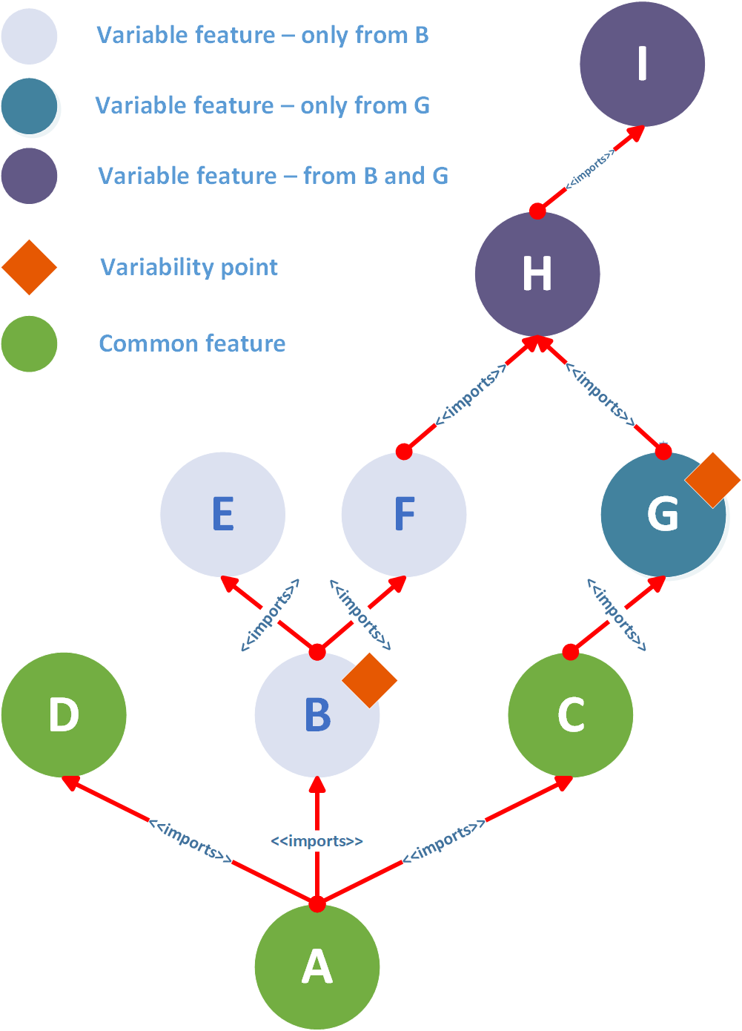
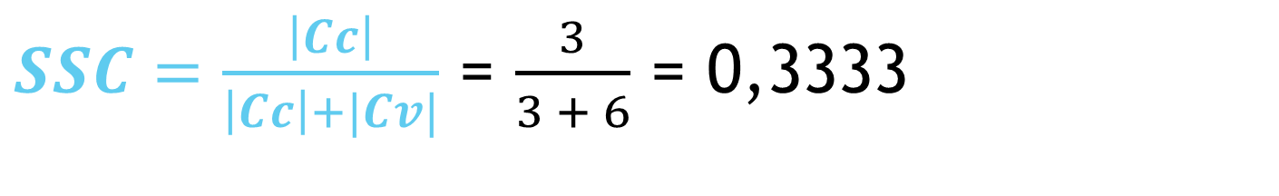
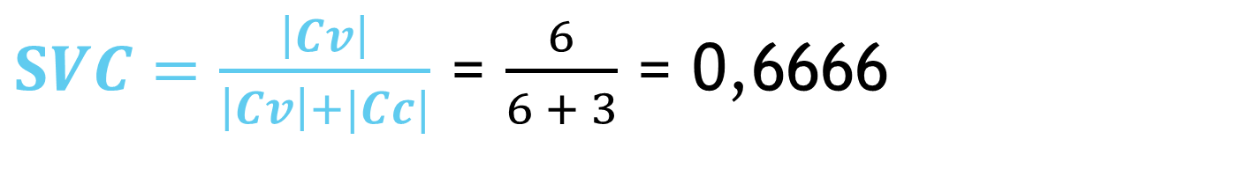
$SSC=\frac{\left|Cc\right|}{\left|Cc\right|+|Cv|}$ = $\frac{3}{3 + 6}$ = 0,3333
Evaluating variability and commonality
our adaptation to make assumptions on partial components
Structure similarity coefficient
$SVC=\frac{\left|Cv\right|}{\left|Cv\right|+|Cc|}$ = $\frac{6}{6 + 3}$ = 0,6666
Structure variability coefficient
Tao Zhang, Lei Deng, Jian Wu, Qiaoming Zhou, and Chunyan Ma. 2008.
Some Metrics for Accessing Quality of Product Line Architecture.
In 2008 International Conference on Computer Science
and Software Engineering. IEEE, Wuhan, China, 500–503.
https://doi.org/10.1109/CSSE.2008.500
SSC = 1 - SVC
For components
Mutually conditional

Slide 47


Measuring Reuse Rate
$$CRR=\frac{\text{Σ}\text{i} \text{Ex}\text{|}\text{M}\text{i}\text{|}}{\text{|}\text{M}\text{|}}$$
1 if component is included in given member i otherwise 0 (interior)
(If component is interior then $\text{Ex}\text{|}\text{M}\text{i}\text{|}$ = 1 otherwise 0)
Component reuse rate
Number of all members of SPL
Usable when all ARCHITECTURES SHOULD BE DERIVED
CRR for common components will be 100%
- in all derivations (architectures)
The higher CRR of the component,
the more important for SPL is
(for reuse)
$$RBR=\frac{\text{Σ}\text{k} \text{Cost} \text{C}\text{k}}{\text{Σ}\text{j} \text{Cost} \text{C}}$$
Quality of given product line member k
Reuse benefit rate
Quality of all components in SPL
The higher RBR, the more reusable SPL is (the more members has)

Slide 48
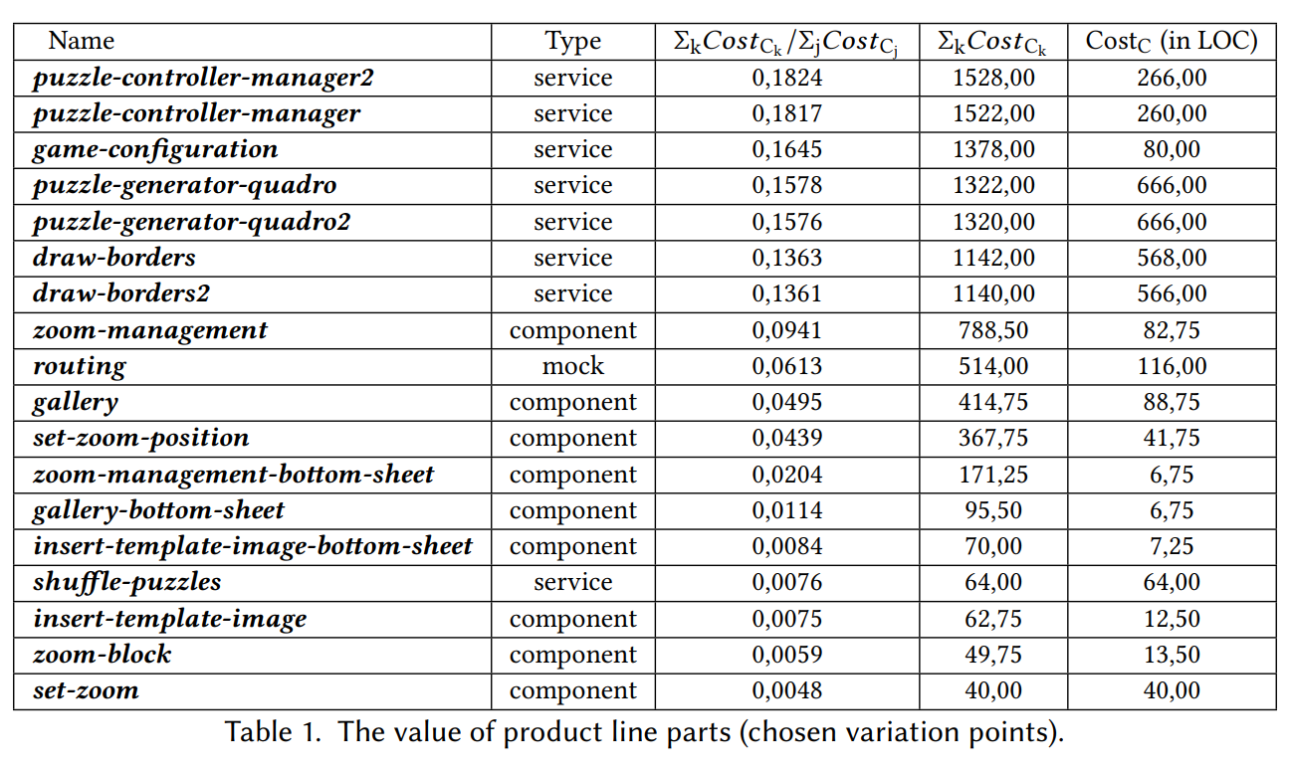
Where $The Cost of all components in SPL=\text{Σ}\text{j} \text{Cost} \text{C}$= 8378,25

Slide 49
Agenda
Software product lines – what are they used for?
Motivation – research on variability in parallel with software quality, and extraction of knowledge from related products
Resolving commonality and variability in TypeScript stateful applications
Evaluating the effectiveness of software product line establishment
presented on prepared stateful canvas-based TypeScript SPA product line
Supporting product line evolution by extraction and comprehension of knowledge from related software products (presented on the real use-case)
presented on prepared fractal recursion-based product line
Various data representations of software product features and capabilities
Evaluation of models for aesthetics assignment and quality of resulting products
Results and future work, Bibliography

Slide 50
Evaluating customized dataset
Already 378 fractals generated from one file
-based on permutations of variation points
and recursion
Can be more, but...
Manual annotations – based on own aesthetics
Used third party model
-comparing different fractal representations/formats:
Vector graphics – whole structure is written as text .SVG
Raster graphics
Information from variation points
inserts knowledge from structure of program generator itself into data
we bring:
asymmetry, chaos, standalone lines
creating non-fractal shape
EASY TO EXECUTE AND
ANALYZE FRACTAL SCRIPT
IN MANY PROGRAMMING
LANGUAGES
js2py for Python
Will it help to enhance third party models and systems?
-improve their accuracy

Slide 51
Meta-model for VML language instance descriptions
Information about the
type of variability model
Syntactic information
about action
-action name,
-number of parameters
One form of
evaluation
Transforms target
models based on configurations
VML LANGUAGES
Model-transformation code
Generates trace links
- VML4RE
- VML4Arch
(parser, something based
on model elements,…)
Additional information for action
associated with transformation
of target models
Rashid, A., Royer, J., & Rummler, A. (Eds.). (2011). Aspect-Oriented, Model-Driven
Software Product Lines: The AMPLE Way. Cambridge: Cambridge University
Press. doi:10.1017/CBO9781139003629

Slide 52
Meta-model for variability management
Rashid, A., Royer, J., & Rummler, A. (Eds.). (2011). Aspect-Oriented, Model-Driven
Software Product Lines: The AMPLE Way. Cambridge: Cambridge University
Press. doi:10.1017/CBO9781139003629

Slide 53
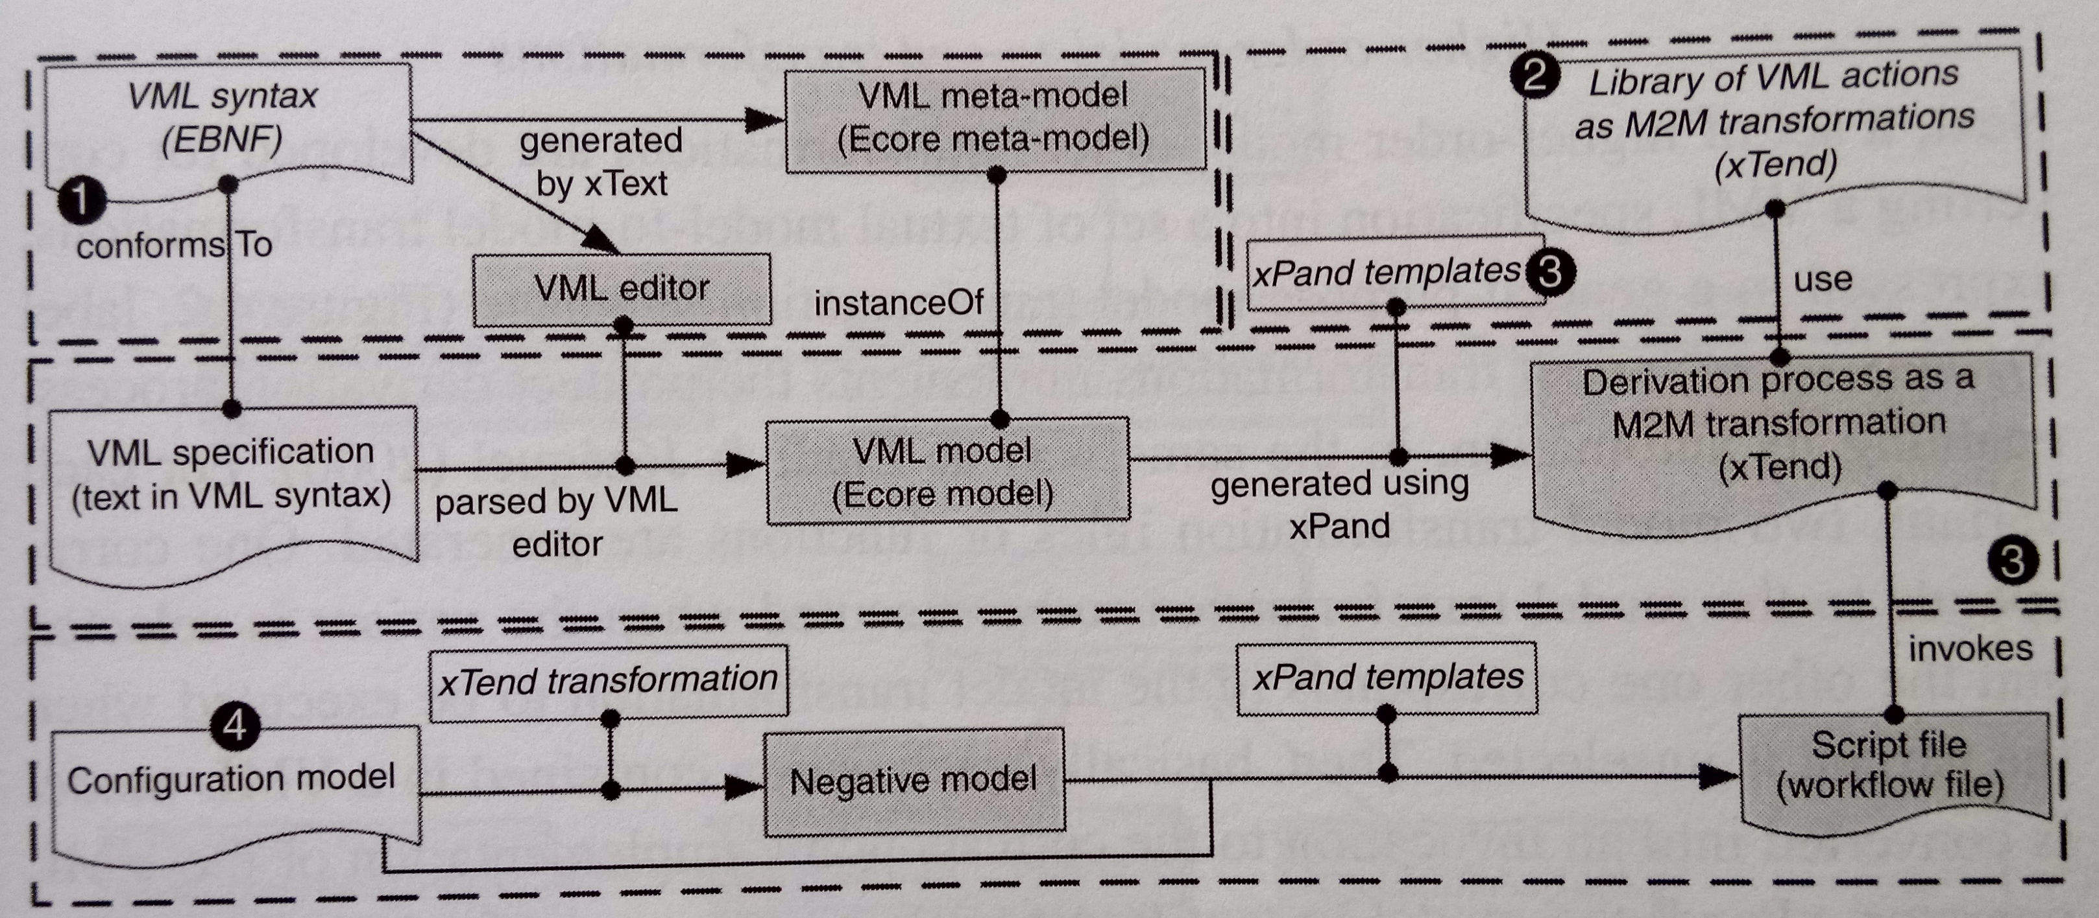
VML language – the process
TRANSFORMATION
LANGUAGES
xTend – model-to-text
xPand – model-to-model
Rashid, A., Royer, J., & Rummler, A. (Eds.). (2011). Aspect-Oriented, Model-Driven
Software Product Lines: The AMPLE Way. Cambridge: Cambridge University
Press. doi:10.1017/CBO9781139003629

Slide 54
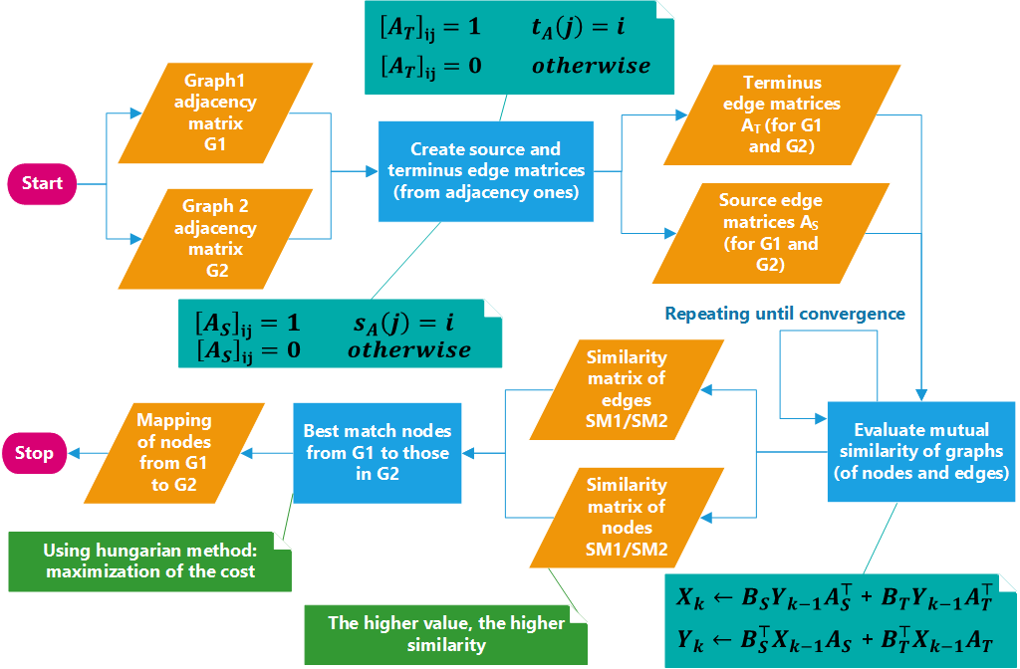
Matrix-based graph comparisons based on node-edge similarity
ZAGER, Laura A. a George C. VERGHESE, 2008. Graph similarity scoring and matching. Applied Mathematics Letters [online]. 2008, roč. 21, č. 1, s. 86–94. ISSN 08939659. Dostupné na: doi:10.1016/j.aml.2007.01.006

Slide 55
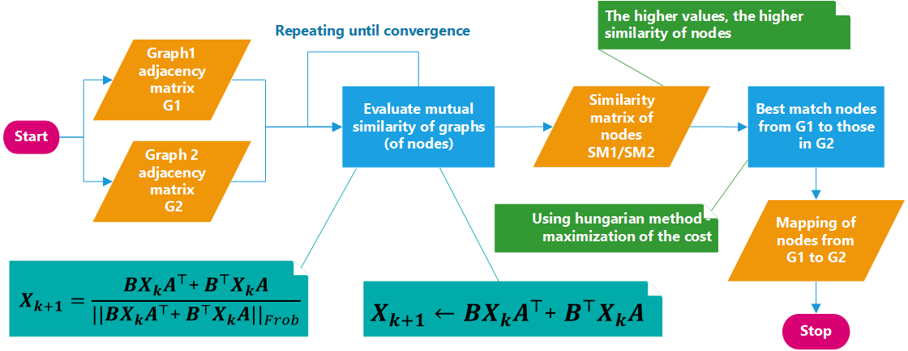
Matrix-based graph comparisons based on node similarity
BLONDEL, Vincent D., Anahí GAJARDO, Maureen HEYMANS, Pierre SENELLART a Paul VAN DOOREN, 2004. A Measure of Similarity between Graph Vertices: Applications to Synonym Extraction and Web Searching. SIAM Review [online]. 2004, roč. 46, č. 4, s. 647–666. ISSN 0036-1445, 1095-7200. Dostupné na: doi:10.1137/S0036144502415960
ZAGER, Laura A. a George C. VERGHESE, 2008. Graph similarity scoring and matching. Applied Mathematics Letters [online]. 2008, roč. 21, č. 1, s. 86–94. ISSN 08939659. Dostupné na: doi:10.1016/j.aml.2007.01.006

Slide 56
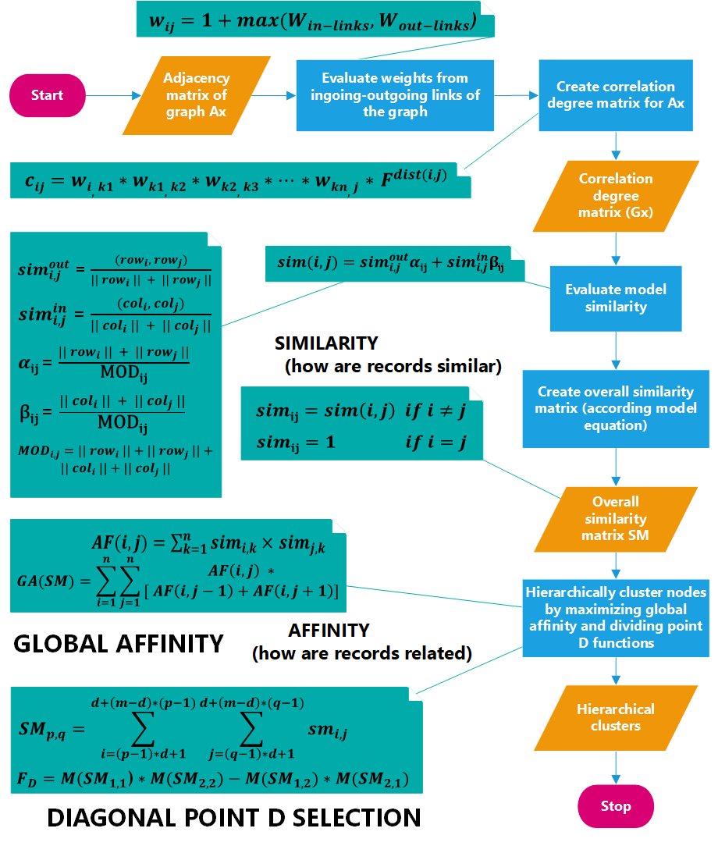
Matrix-based hierarchical clustering
HOU, Jingyu, Yanchun ZHANG a Jinli CAO, 2003. Web Page Clustering: A Hyperlink-Based Similarity and Matrix-Based Hierarchical Algorithms. V: Xiaofang ZHOU, Maria E. ORLOWSKA a Yanchun ZHANG, ed. Web Technologies and Applications [online]. Berlin, Heidelberg: Springer Berlin Heidelberg, Lecture Notes in Computer Science, s. 201–212 [cit. 3.12.2022]. ISBN 978-3-540-02354-8. Dostupné na: doi:10.1007/3-540-36901-5_22

Slide 57
Domain analysis Creation of features

Slide 58
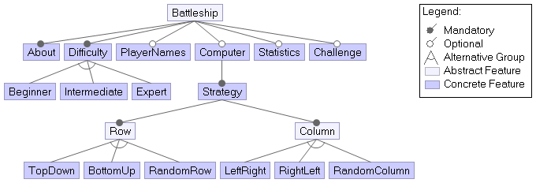
Example of Given solution
Text interface
Console game – can play using command line
Real application
Feature analysis already created – domain already analyzed
Suitable for next implementation and improvements

Slide 59
Problems of given solution
Created only mandatory features in a way that not provides:
product derivation
Voluntary features in configurable way
Hardcoded functionality – needs refactoring
Option to choose from options (in case of difficulty in game)
Only console environment – (we will not remake)
No code reuse – repetition on many places
Still not extensive game – (but real application for given domain)
Lack of encapsulation and object oriented features
Needs divide static method to appropriate classes
Needs manage access from parent object
Business concerns are not fully separated

Slide 60
Design with aspects as voluntary functionality
Aspect can be removed from execution – variable functionality
Aspect can intercepts points in execution and helps to derive product
Good to extend functionality in various ways
Add voluntary features
Choosing specific strategy from strategy options – from mandatory ones too
Enhance necessary functionality on existing classes (includes classes of additional features)

Slide 61
Mandatory parts in the game
Prints info
at the beginnning
Implemented
Using
aspect
Only random number for rows and columns

Slide 62
Our focus - focus on variable features
Chosing one feature
From set can be
Implemented
in aspect oriented way
+ maybe other potential improvements from observed domain
clever
From the same
author in another
his scatch

Slide 63
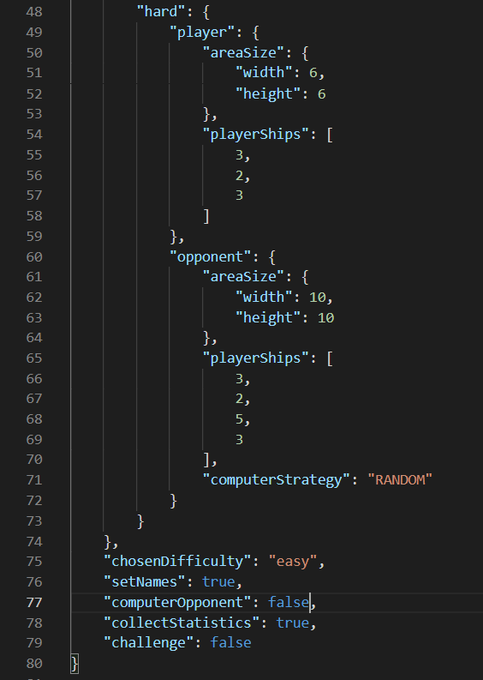
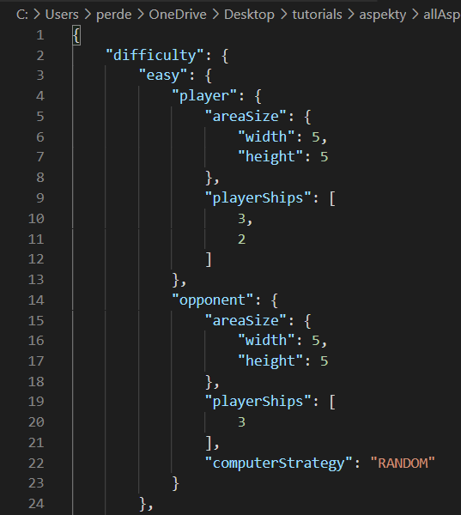
Configuration using JSON File

Slide 64
Config to feature model mapping

Slide 65
Quality of applying voluntary features using AspectJ
More complex AspectJ solution in some case
2x as long
PROBLEMS
Redundant use of parameters in AspectJ pointcuts
Scope problem
Need of using state extension
Variables can be accessed by priviledged aspects
Use hook methods to extend context
Inability to create own exception for new Aspects
Use of dynamic exceptions is required

Slide 66
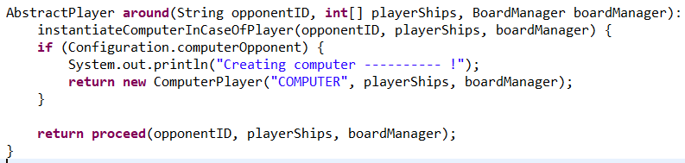
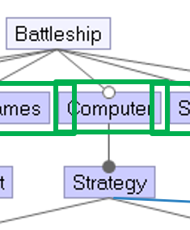
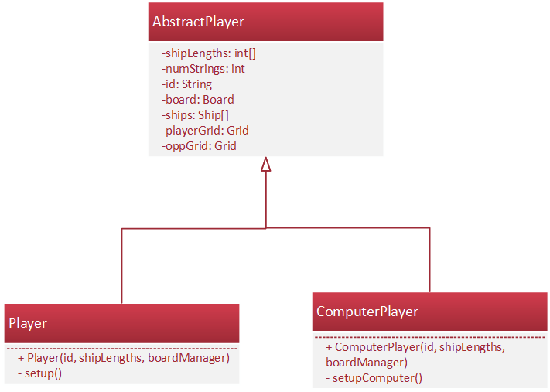
Pattern Cuckoo’s egg
Created if
condition is
met
Created by default

Slide 67
Product derivation
PROBLEM SPACE → SOLUTION SPACE

Slide 68
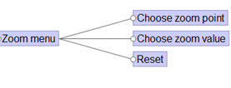
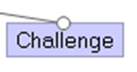

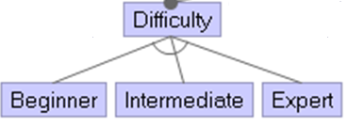
Types of variations
SET OF INSTANCES OUT OF SEVERAL ALTERNATIVES
OPTIONAL
VARIATION
INSTANCE OF SEVERAL INSTANCES
k instances from
n instances
0 or 1 instance
1 instance from
n instances
Felix Bachmann and Len Bass. 2001. Managing Variability in Software Architectures. (2001), 7.

Slide 69
Derivation rules
{“computer”: “true”}
{“difficulty”: “beginner”}
{“statistics”: “true”}
{“playerNames”: “true”}
{“challenge”: “true”}
{}
{“computer”: “true”,
“strategy”: “true”}

Slide 70
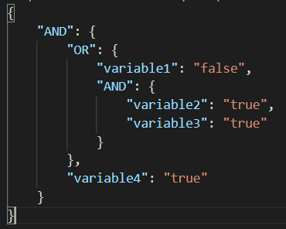
AND or OR JSON TREE
(variable1 OR (Variable2 AND variable3)) AND variable4
2. If given variable variable1 is false in config then
OR is true, otherwise remaining branches should be true
1. If given variables in config are both true, then
AND above is true
3. If given variable variable4 is true in config and
whole OR is true, then parent AND is true
4. If whole is true, then we can copy annotated method

Slide 71
Applied annotations types
//@{}
//#{}
//%{}
For whole
class/aspect/interface
For class/aspect
method only
For import
statement only
Copying of whole file with class
Copying of given method
Copying of given import
//@{}
//#{}
//%{}

Slide 72
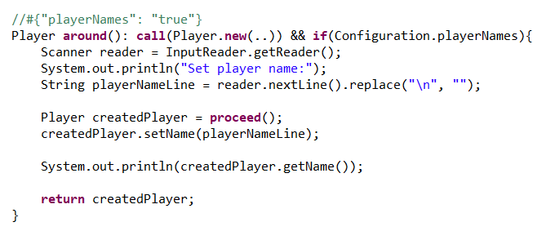
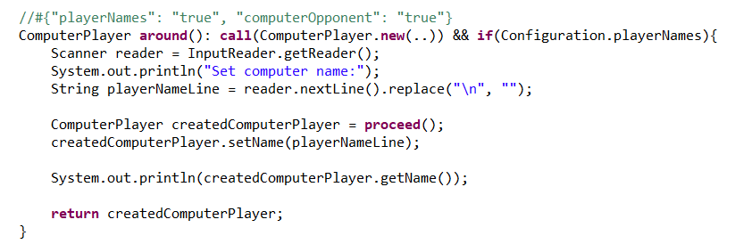
Variables features can interfere
Setting names for players needs update when computer player is added
Variable feature for
setting player names
We can’t use //@ annotation,
because of many different variable features
Method will be included only if all conditions are met (for specific feature)
Additional variable
feature for
managing also
computer name

Slide 73
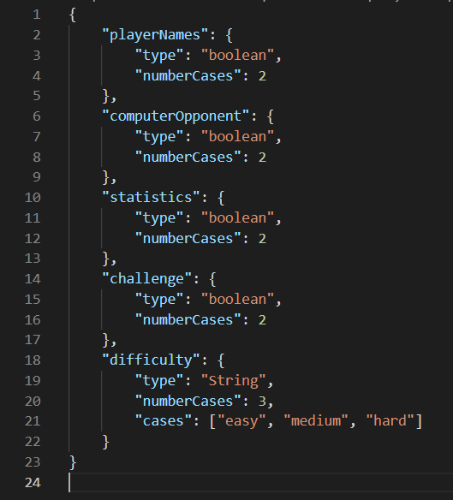
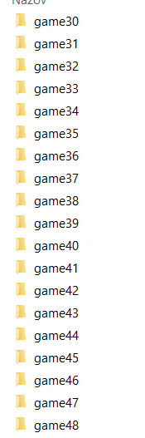
Generating all cases
variableRestrictions.json
2
2
48
2
2
3

Slide 74
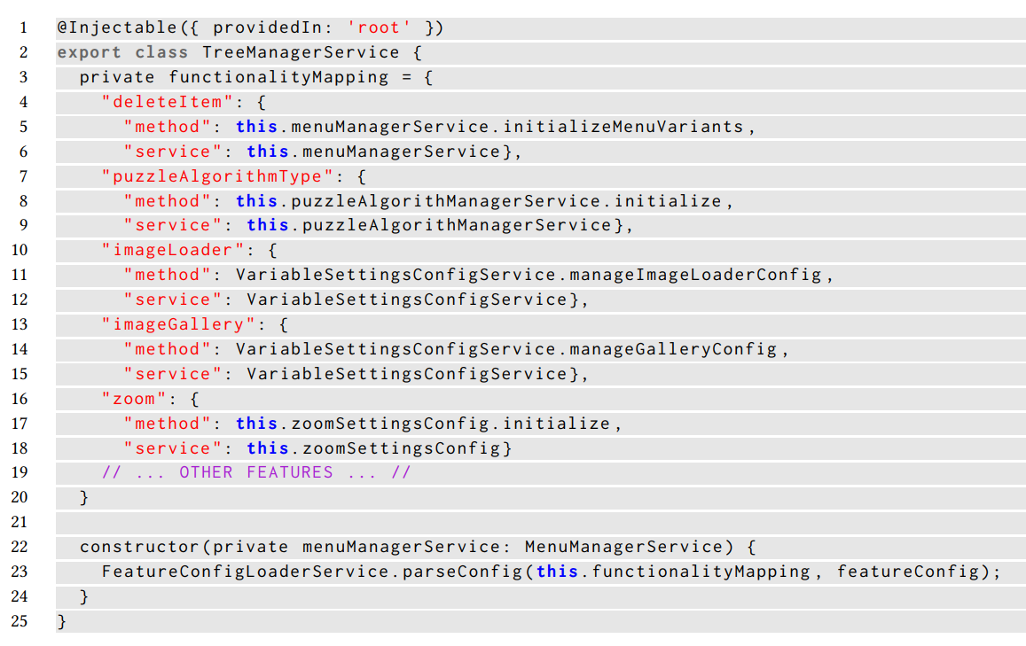
STEP 1: Separation of “aspects” from code
Initial method to apply
aspect for given feature
SEPARATION OF
FEATURE MANAGEMENT
Service reference which enables to work with inner attributes
FEATURES
Loads values from
configuration file

Slide 75
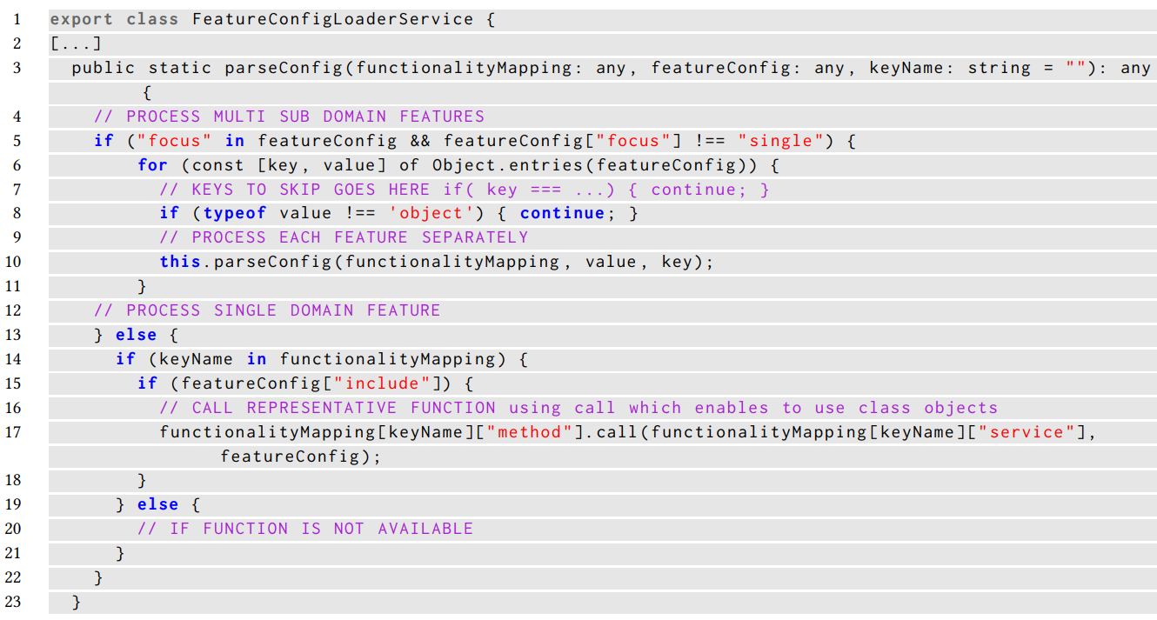
2. LOADING VARIABLES WHICH REPRESENT
FEATURES FROM CONFIGURATION FILE

Slide 76
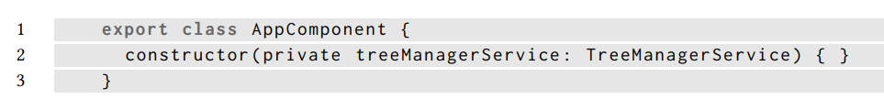

Aspect example – to-aop library
3. CONNECTS FEATURE MANAGEMENT WITH THE
BUSINESS LOGIN ONLY IN ONE PLACE
CONFIGURATION FILE

Slide 77

2. ASPECT
DEFINITION

Slide 78


3. NATIVE SERVICE AND TEMPLATE
SERVICE
TEMPLATE

Slide 79

STEP 2: Creating and annotating functionality
REMOVING ONLY ONE DEPENDENCY ON ASPECTS FROM CONSTRUCTOR

Slide 80

Example: using expressions inside template

Slide 81


Example: Making gallery variable
Example: Gallery should be variable (condition: natively is accessed by routing)
1. Annotate entire class for future exclusion
2. Annotate gallery imports
for future exclusion

Slide 82

3. Annotate mock data, only those which belongs to the gallery
STEP 3: Product derivation
-starting derivator

Slide 83
Evaluation

Slide 84


Measuring variability
DEPENDANCE RELATIONS
CONSTRAINTS
Value of one variability
point affects another
More difficult to bind
variability point in PLA
STRONG COUPLED
VARIABILITY POINTS
STRONG COUPLING
Independent variability points
(no dependence relation with others
– no value of any variability point affects another one)
$$SCC=1 − \frac{\left|IVP\right|}{|VP|}$$
Less difficulty to bind
variability point in PLA
Strong coupling coefficient
Number of variability points
More difficult variability
design of PLA
Weak coupling variability points
(2 or more variability points controlling guard condition
of some variability point(s), components,…)
WEAK COUPLING
$$WCC=\frac{\left|CVP\right|}{|VP|}$$
Weak coupling coefficient
Tao Zhang, Lei Deng, Jian Wu, Qiaoming Zhou, and Chunyan Ma. 2008.
Some Metrics for Accessing Quality of Product Line Architecture.
In 2008 International Conference on Computer Science
and Software Engineering. IEEE, Wuhan, China, 500–503.
https://doi.org/10.1109/CSSE.2008.500
Number of variability points

Slide 85
Where $The Cost of all components in SPL=\text{Σ}\text{j} \text{Cost} \text{C}$= 8378,25

Slide 86

Application on fractals

Slide 87
Many possible derivations of fractals
Fractal domain
Fractal derivation
Aesthetic feeling
Product derivation
Product validation
EXTENSIVE SOLUTION SPACE

Slide 88
How to catch all feature variability?
A need for best product derivator
When domain is focused on our aesthetic perception
In there suitable feature diagram?
A need to generate all possible derivations.
Can they include only mathematical model?

Slide 89



Given samples of one type

Slide 90




Slide 91



Many types
Different approaches how to generate

Slide 92
The Need for framework
extension for based on previous work, but focused mainly on variability
Iteratively building and
enhancing framework
Variability configuration
Repeating the same code fragments
– addinional for cyckle with different range in each iteration
Combining many code parts
Excluding optional code parts from some derivations
variables
function parameters
permutation of variables
Recursion depth is the most important dependency
precalculating values to log them together
Logging

Slide 93
Evaluating customized dataset
Already 378 fractals generated from one file
-based on variability points permutations
and recursion
Can be more, but...
we bring:
assymetry, chaos, standalone lines
creating non-fractal shape
Manual annotations – based on own aesthetics
Used third party model
-comparing different fractal representations/formats:
Vector graphics – whole structure is written as text .SVG
Raster graphics
Information from variability points
inserts knowledge from structure of program generator itself into data
EASY TO EXECUTE AND
ANALYZE FRACTAL SCRIPT
IN MANY PROGRAMMING
LANGUAGES
js2py for Python
Will it help to enhance third party models and systems?
-improve their accuracy

Slide 94
Evaluating aesthetic perception on third party model - bias
What model sees:
28 X 28 px
600 X 600 px
https://github.com/vatsal-rooprai/Image-Aesthetic-Evaluation

Slide 95

Can actual results from model be used as label values?
For evaluation
– learning with teacher needs annotated data
Are all values of the same value?
Yes if borders of images are filled to the same size
No, if we take original images
– how far fractal can be extended
Evaluated model data
Is model suitable for evaluating fractals?
Maybe yes, but evaluation is also focused mainly on:
colors, golden cut, perspective,
view of the spectator/camera
OWN MODEL IS REQUIRED
-restrict it on shapes only/mainly
-better if deformations were detected and evaluated accordingly

Slide 96


Can serve as restricted „reference“
for further evaluation

Slide 97

Generated permutations
Not all are suitable,
but for completeness....
WHY?
Changeability
inside recursion
Variable size has value 200,
As the same as values of variables:
lineLength = 10
thickness = 1
What we should be focusing on?
Dependency
of recursion depth
More so than other variables inside recursion

Slide 98
What next with fractals?
Analyze already harvested content to observe if catched variability can be used to improve (in automatic way):
Accuracy of third party systems (evaluating aesthetics)
Variability points – decomposing them, adding new ones, checking their suitability
Build own model for fractals only – RESEARCH THE EVOLUTION OF SPL
Build GAN to generate similar fractals – analyze impact of product in SPL evolution
try to design variability points based on the best ones
Related to evaluation/statistics? –mainly to variability points in general
-contingency/pivot tables
-association tables
-agreement studies
Topic in statistics course

Slide 99



Difficulty configuration
Prepare configuration (with difficulty settings) before creating player’s specific instance
1. PREPARATION
2. POINTCUTS
The same pointcuts
(with other names)
“Hook“ functions

Slide 100

3. APPLYING CONFIGURATION VALUES
Calling the method with the same name but other arguments,
to apply other aspect managing player’s instance (showed previously)

Slide 101



Slide 102



Slide 103
Software design according feature diagram
Given functionality can spread trough whole system – in not modular systems
This functionality can be voluntary – marked in feature diagram this way
For using aspects codes should be created according some principles
How to derive product with / without given feature if feature has many classes and its implementation can include aspects too
NEED TO KNOW CERTAIN DOMAIN

Slide 104



Slide 105



Adding support for computer or user opponent
Player as opponent
Computer as opponent
Changes to use both – aspect use
…
…
Like “hooks”

Slide 106

Mapping of pointcuts
…
…

Slide 107


Statistics configuration
MOVES
HITS
Statistics observation are gathered
if value of variable from config file is True
MISS = MOVES - HITS
Statistics objects are stored in hash-map

Slide 108


Slide 109


Variable encapsulation problem
In player instance chooser aspect:
The same problem
To call function to manage computer guess,
which should not be publicly visible

Slide 110
Product derivation
PROBLEM SPACE → SOLUTION SPACE

Slide 111


Slide 112


Slide 114


Slide 115
Object oriented redesign
Hardcoded parts should be changed to support configurability
Different lengths of board
Support for adding player
Concerns should be separated
Setup of player should be part of player class
Setup of computer should be part of computer class
Static methods should be replaced by objects
Performing refactoring of project

Slide 116

Schema after refactoring

Slide 117

Quality checker structure

